Slide 1

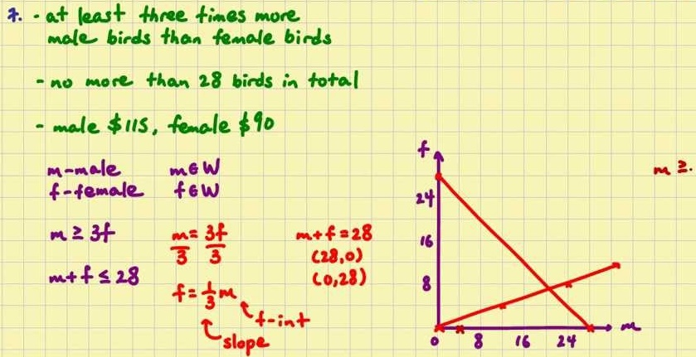
Mathematics (9-1) - iGCSE
2018-20
Year 07
Units 1-4 – Number, Algebra, Graphs, Fractions & Percentages

Slide 2
Contents
Page iv
1 Number 1
1.1 Calculations 1
1.2 Decimal numbers 2
1.3 Place value 2
1.4 Factors and multiples 3
1.5 Squares, cubes and roots 4
1.6 Index notation 5
1.7 Prime factors 6
1 Problem-solving 7
2 Algebra 8
2.1 Algebraic expressions 8
2.2 Simplifying expressions 8
2.3 Substitution 9
2.4 Formulae 10
2.5 Expanding brackets 11
2.6 Factorising 12
2.7 Using expressions and formulae 13
2 Problem-solving 14
3 Graphs, tables and charts 16
3.1 Frequency tables 16
3.2 Two-way tables 16
3.3 Representing data 18
3.4 Time series 18
3.5 Stem and leaf diagrams 19
3.6 Pie charts 20
3.7 Scatter graphs 22
3.8 Line of best fit 23
3 Problem-solving 23
4 Fractions and percentages 25
4.1 Working with fractions 25
4.2 Operations with fractions 26
4.3 Multiplying fractions 27
4.4 Dividing fractions 28
4.5 Fractions and decimals 28
4.6 Fractions and percentages 29
4.7 Calculating percentages 1 30
4.8 Calculating percentages 2 31.
4 Problem-solving 32

Slide 3
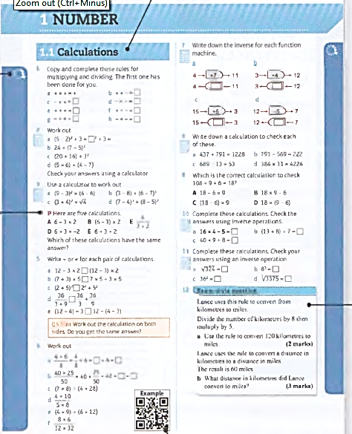
Contents
Page v
Icons alongside the questions show their level of difficulty. Questions in this book will range from 2
to 8
There is a section relating to every mastery lesson in the Student Book
This Practice Book is packed with extra practice on all the content of the Student Book - giving you more opportunities to practise answering simple questions as well as problem-solving and reasoning ones.
The letters P and R are used to show where a question requires you to problem- solve or reason mathematically- essential skills for your GCSE.
Exam-style questions are included throughout to help you prepare for your GCSE exam.
QR codes link to worked examples from the Student Book which will help you with the question they are alongside.

Slide 4
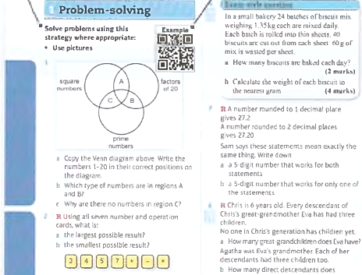
Contents
Page vi
These are strategies that you have learned so far in the Student Book. They build up as you work through the book. Consider whether they could help you to answer some of the following questions.
A QR code is given in the problem solving section where you learn a new strategy in that unit in the Student Book. Scan it to see the worked example and remind yourself of the strategy.
The R symbol indicates questions where you are required to reason mathematically. Questions in this section do not have the P symbol as they are all problem-solving.

Slide 5

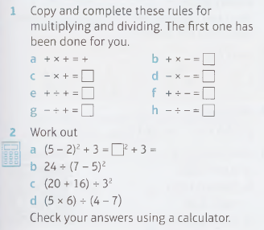
1 – Number - Calculations
Page 1
1.1 - Calculations

Slide 6
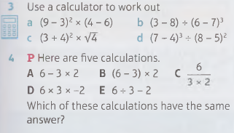
1 – Number - Calculations
Page 1
1.1 - Calculations

Slide 7
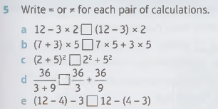
1 – Number - Calculations
Page 1
1.1 - Calculations
Q5 hint - Work out the calculation on both sides. Do you get the same answer?

Slide 8
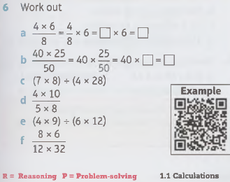
1 – Number - Calculations
Page 1
1.1 - Calculations

Slide 9
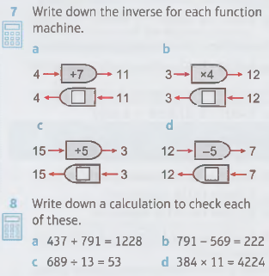
1 – Number - Calculations
Page 1
1.1 - Calculations

Slide 10
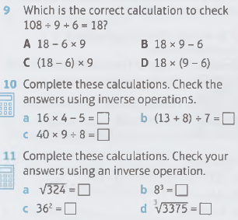
1 – Number - Calculations
Page 1
1.1 - Calculations

Slide 11
1 – Number - Calculations
Page 1
12 – Exam-Style Questions
Lance uses this rule to convert from
kilometers to miles.
Divide the number of kilometers by 8 and then multiply by 5.
Use the rule to convert 120 kilometers to miles. (2 marks)
Lance uses the rule to convert a distance in kilometers to a distance in miles. The result is 60 miles,
What distance in kilometers did Lance convert to miles? (3 marks)

Slide 12
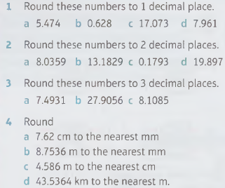

1 – Number – Decimal Numbers
Page 2
1.2 – Decimal Numbers

Slide 13
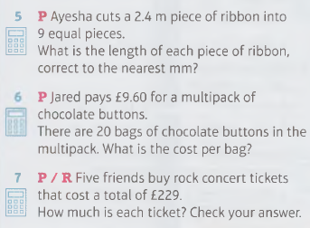
1 – Number – Decimal Numbers
Page 2
1.2 – Decimal Numbers

Slide 14
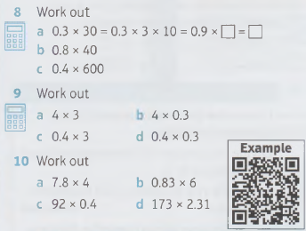

1 – Number – Decimal Numbers
Page 2
1.2 – Decimal Numbers

Slide 15

1 – Number – Decimal Numbers
Page 2
11 – Exam-Style Questions
Sharon is buying drinks for a children’s party.
Juice costs £1.15 per litre.
Cola costs £1.35 per litre.
Sharon buys 10 litres of juice and 5 litres of cola. She pays with a £20 note. Work out how much change she should get. (3 marks)

Slide 16
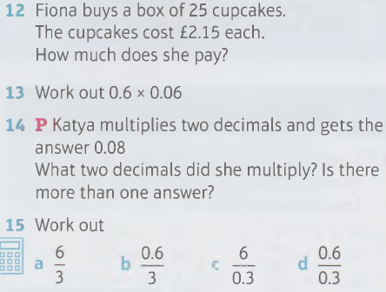
1 – Number – Decimal Numbers
Page 2
1.2 – Decimal Numbers

Slide 17
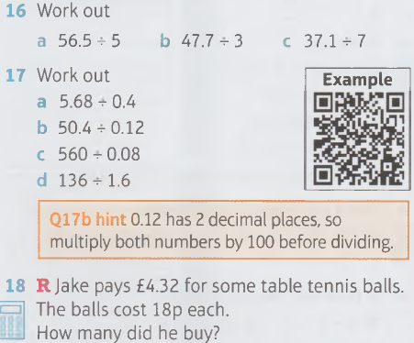

1 – Number – Decimal Numbers
Page 2
1.2 – Decimal Numbers
Q17b hint - 0.12 has 2 decimal places, so multiply both numbers by 100 before dividing.

Slide 18
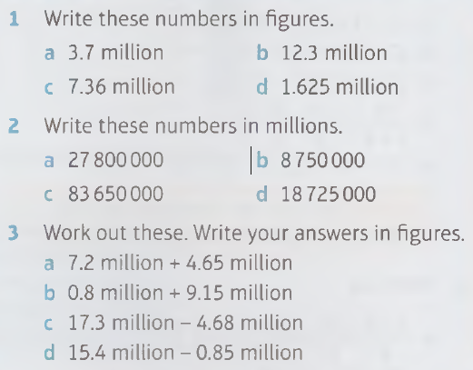

1 – Number – Place Value
Page 2
1.3 – Place Value

Slide 19

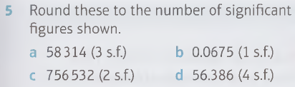
1 – Number – Place Value
Page 2
1.3 – Place Value
Q4a hint - The 4th significant figure of 638.729 is 7. The next digit is 2, so leave the 7 as it is.

Slide 20
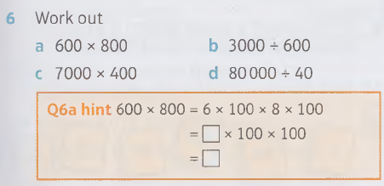
1 – Number – Place Value
Page 3
1.3 – Place Value

Slide 21
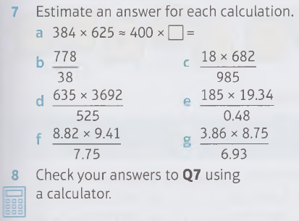
1 – Number – Place Value
Page 3
1.3 – Place Value

Slide 22
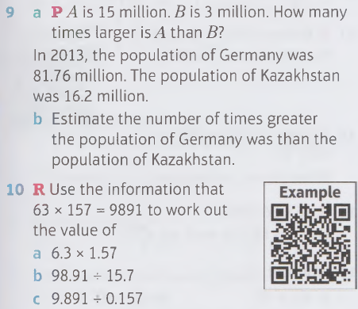
1 – Number – Place Value
Page 3
1.3 – Place Value

Slide 23
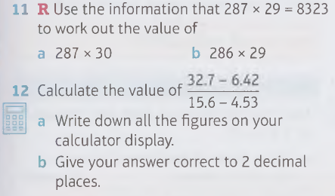
1 – Number – Place Value
Page 3
1.3 – Place Value

Slide 24
1 – Number – Place Value
Page 3
P One set of Christmas lights flashes every 15 seconds. A second set flashes every 25 seconds. They both flash together at 8 pm exactly.
After how long will they next flash together?

Slide 25
1 – Number – Factors and Multiples
Page 3
1.4 – Factors and Multiples
List the prime numbers between 30 and 50.
List the prime numbers between 70 and 90.
R The product of two prime numbers is always odd. Is this true or false?
List all the factors of 48.
List all the factors of
a 24 b 42 c 50

Slide 26

1 – Number – Factors and Multiples
Page 3
1.4 – Factors and Multiples
Find the HCF of
a 18 and 45 b 28 and 84
c 32 and 80 d 12, 36 and 54
a Write out the first 10 multiples of:
i 4 ii 5
b Ring the common
multiples of 4 and 5.
c Which is the LCM of 4 and 5?
Find the LCM of
a 3 and 8 b 6 and 15
c 4 and 7 d 16 and 24
e 3, 5 and 9

Slide 27
1 – Number – Factors and Multiples
Page 3
1.4 – Factors and Multiples
Find the HCF and LCM of
a 24 and 36
b 15 and 20
R Write two numbers with an HCF of 18.
R Write two numbers with an LCM of 60.

Slide 28
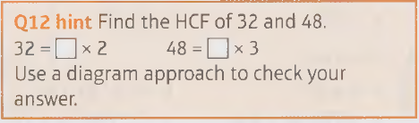
1 – Number – Factors and Multiples
Page 3
P Marta is making gift bags. She wants each to be the same with no items left over.
Marta has 32 loom bracelets and 48 chocolate bars. What is the greatest number of gift bags she can prepare?

Slide 29
1 – Number – Factors and Multiples
Page 3
P One set of Christmas lights flashes every 15 seconds. A second set flashes every 25 seconds. They both flash together at 8 pm exactly.
After how long will they next flash together?

Slide 30
1 – Number – Factors and Multiples
Page 3
14 – Exam-Style Questions
Sophie is making Christmas cards.
She needs a card and an envelope for each card.
There are 18 card blanks (for her to decorate) in a pack.
There are 30 envelopes in a pack.
Sophie bought exactly the same number of cards and envelopes.
How many packs of cards and envelopes did she buy?
(3 marks)
How many cards can she make? (2 marks)

Slide 31
1 – Number – Factors and Multiples
Page 3
1.4 – Factors and Multiples
P Three cars are going around a rally race track.
The first car completes a circuit every 0.25 hours, the second car every 0.4 hours and the third car every 0.5 hours. They start together at 2 pm. How long is it before all three cars are level again?

Slide 32
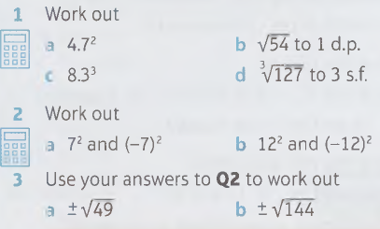
1 – Number – Squares, Cubes & Roots
Page 4
1.5 – Squares, Cubes and Roots
Q3 hint - The symbol ± shows that you are being asked for the positive and the negative square root.

Slide 33
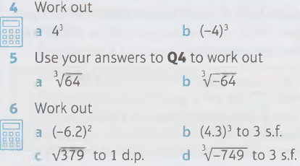

1 – Number – Squares, Cubes & Roots
Page 4
1.5 – Squares, Cubes and Roots

Slide 34
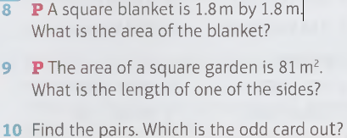
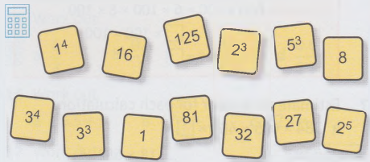
1 – Number – Squares, Cubes & Roots
Page 4
1.5 – Squares, Cubes and Roots

Slide 35
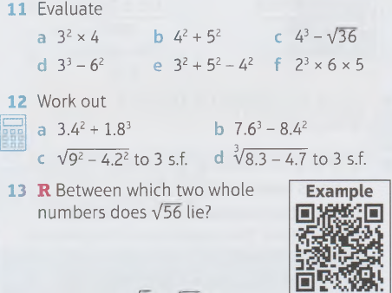
1 – Number – Squares, Cubes & Roots
Page 4
1.5 – Squares, Cubes and Roots

Slide 36
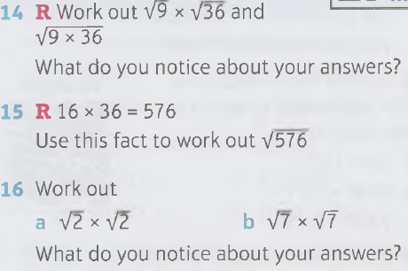
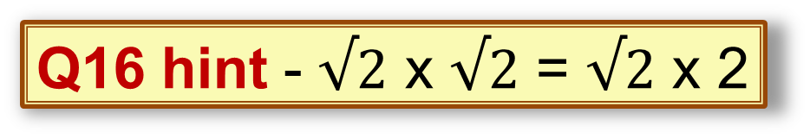
1 – Number – Squares, Cubes & Roots
Page 4
1.5 – Squares, Cubes and Roots
Q16 hint - $√2$ x $√2$ = $√2$ x 2

Slide 37

1 – Number – Squares, Cubes & Roots
Page 4
1.5 – Squares, Cubes and Roots
17 – Exam-Style Questions
Use your calculator to work out the value of 7.43 x $√3$.
Write down all the figures on your calculator display.
(1 mark)
Write your answer to part a correct to 1 decimal place.
(1 mark)

Slide 38

1 – Number – Squares, Cubes & Roots
Page 4
1.5 – Squares, Cubes and Roots
18 – Exam-Style Questions
Use your calculator to work out:
$$\sqrt{\frac{32.6 X 13.9}{7.4}}$$
Write down all the figures on your calculator display.
(2 marks)

Slide 39
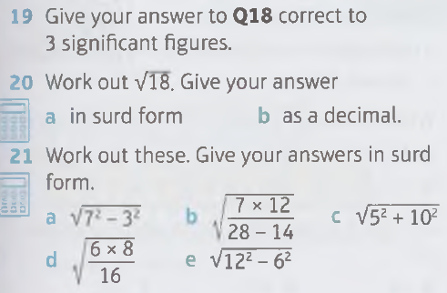
1 – Number – Squares, Cubes & Roots
Page 5
1.5 – Squares, Cubes and Roots

Slide 40
1 – Number – Index Notation
Page 5
1.6 – Index Notation
Copy and complete the pattern.
2³ = 2
2² = 2 x 2 = □
2³ = 2 x 2 x 2 = □
2⁴ = 2 x 2 x 2 x 2 = □
2⁵ = _____
2⁶ = _____
Copy and complete.
6 x 6 x 6 x 6 x 6 x 6 x 6 = 6 □
7 x 7 x 7 = 7 □
8 x 8 x 8 x 8 x 8 = 8□
Write as a product.
a 3⁶ b 4⁵ c 9⁴

Slide 41
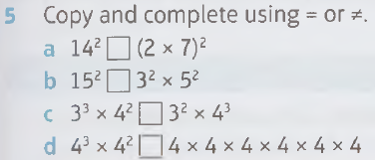
1 – Number – Index Notation
Page 5
1.6 – Index Notation
Write each product using powers:
5 x 5 x 5 x 5 x 5
8 x 8 x 8
3 x 3 x 3 x 3 x 3 x 4 x 4
5 x 5 x 7 x 7 x 7 x 7
Q5 hint - Work out the calculation on both sides. Do you get the same answer?

Slide 42
1 – Number – Index Notation
Page 5
1.6 – Index Notation
Find pairs with the same value.
Write these expressions as a single power.
a 6³ x 6⁵ b 7⁷ x 7²
c 8 x 8⁵ d 9³ x 9⁶
5⁷
5³ x 5³
5² x 5³
5⁶
5² x 5⁵
5⁷

Slide 43
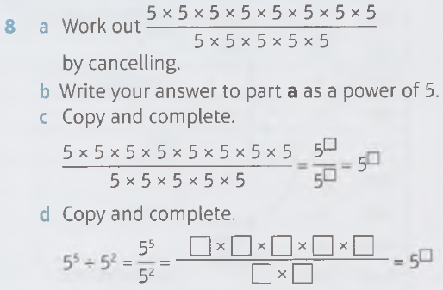
1 – Number – Index Notation
Page 5
1.6 – Index Notation

Slide 44
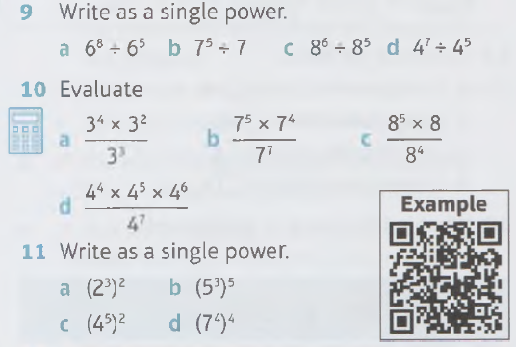
1 – Number – Index Notation
Page 5
1.6 – Index Notation

Slide 45
1 – Number – Index Notation
Page 5
1.6 – Index Notation
12 – Exam-Style Questions
Write as a power of 7
7³ x 7² (1 mark)
7⁸ ÷ 7⁵ (1 mark)
7⁴ x7⁵
7 (1 mark)
(7⁴)² (1 mark)

Slide 46
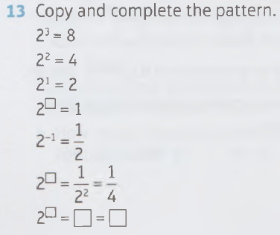
1 – Number – Index Notation
Page 5
1.6 – Index Notation

Slide 47
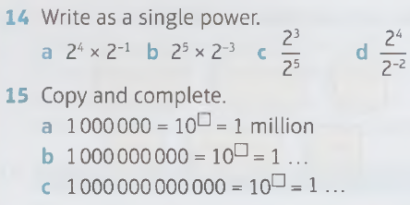
1 – Number – Index Notation
Page 6
1.6 – Index Notation

Slide 48
1 – Number – Index Notation
Page 6
1.6 – Index Notation
Copy and complete the table of prefixes.
Prefix | Letter | Power | Number
tera | T | 10¹²
giga | G | 10⁹
mega | M |  | 1 000 000
kilo | k | 10³
deci | d |  | 0.1
centi | c | 10⁻²
milli | m |  | 0,001
micro | μ | 10⁻⁶
nano | n |  | 0.000 000 001
pico | p | 10⁻¹²

Slide 49
1 – Number – Index Notation
Page 6
1.6 – Index Notation
Copy and complete.
1 centimetre (cm) = □ m
1 gigatonne (Gt)= □ kg
1 microgram (μg) = □ g
1 nanosecond (ns) = □ s
What is 10⁹ tonnes in megatonnes?

Slide 50
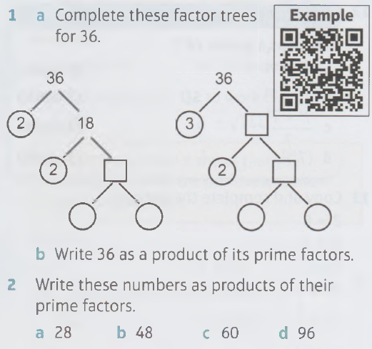
1 – Number – Prime Factors
Page 6
1.7 – Prime Factors

Slide 51
1 – Number – Prime Factors
Page 6
1.7 – Prime Factors
R Farouk says, 'Prime numbers cannot be written as a product of prime factors.'
Is this true or false? Show examples to explain.
Express these numbers as products of their prime factors. Draw Venn diagrams to find the HCF and LCM.
a 48 and 72 b 30 and 84
b 90 and 120
What is 360 as a product of its
A 40x9 B 5 x 8x 9 C 2³ x 3² x 5
D 2³ x 5 x 9 E 5 x 2³ x 9

Slide 52
1 – Number – Prime Factors
Page 6
1.7 – Prime Factors
2² x 3² x 5 is the prime factor decomposition of
A 45 B 90 C 120
D 180 E 360
R Use the information that 19 x 23 = 437 to find the LCM of
a 38 and 23 b 19 and 69
Q7 hint - What type of numbers are 19 and 23? What is the LCM of 19 and 23?
38 = 19 x □ 69 = 23 x □

Slide 53
1 – Number – Prime Factors
Page 6
R The number 600 can be written as a product of its prime factors.
600 = 2³ x 3 x 5²
Are these numbers factors of 600? Explain your answers.
a 24 b 90 c 120
R / P Lenny makes 336 plain biscuits, 216 chocolate biscuits and 144 nutty biscuits. Lenny wants to put all the biscuits into tins.
He wants to have the same number of biscuits in each tin.
The biscuits cannot be mixed.
He wants to buy the largest possible size of tin for the biscuits that can be filled leaving no spaces. How many biscuits should each tin hold?

Slide 54

1 – Number – Prime Factors
Page 6
10 – Exam-Style Questions
The number 3136 can be written as a product of its prime factors:
3136 = 2⁶ x 7²
Write $\sqrt{3176}$ as a product of its prime factors. (2 marks)

Slide 55
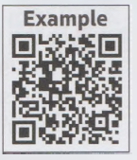
1 – Number – Problem Solving
Page 7
Solve problems using this strategy where appropriate:
Use pictures.
R Using all seven number and operation cards, what is
the largest possible result
the lowest possible result?
Number cards should
be separated by
operation cards.
3
4
5
7
+
-
X

Slide 56
1 – Number – Problem Solving
Page 7
Ian weighs a box which contains 16 glue sticks. It weighs 660g. He then empties the box and weighs it. It weighs 140 g. What is the weight of each glue stick?
The total length of 11 pipes when placed end to end is 15.7 m. The lengths of 3 of the pipes are 1.78m, 0.6m and 3.4m.The rest of the pipes have the same length. What is the length of one of the remaining pipes?
Q2 hint - Read the sentences, one at a time, and include any information on a picture.

Slide 57
1 – Number – Problem Solving
Page 7
4 – Exam-Style Questions
In a small bakery 24 batches of biscuit
mix weighing 1.35 kg each are mixed daily.
Each batch is rolled into one thin sheet.
40 biscuits are cut out from each sheet.
60 g of mix is wasted per sheet.
How many biscuits are baked each day? (2 marks)
Calculate the weight of each biscuit to the nearest gram. (4 marks)

Slide 58
1 – Number – Problem Solving
Page 7
R A number rounded to 1 decimal place gives 27.2
A number rounded to 2 decimal places gives 27.20
Sam says these statements mean exactly the same thing. Write down
a decimal number with 5 digits that works for both statements
a decimal number with 5 digits that works for only one of the statements.

Slide 59
1 – Number – Problem Solving
Page 7
Debbie pays £32.85 per month for her water bill. The rate goes up in February to £41.25 per month but she keeps paying the old amount by standing order.
She has to pay all she owes the water company when she pays her bill in November.
Estimate how much she owes by October to the nearest pound,
Exactly how much should she pay altogether in November?

Slide 60
1 – Number – Problem Solving
Page 7
Copy the Venn diagram above. Write the numbers 1-20 in their correct positions on the diagram.
Which type of numbers are in regions A and B?
Why are there no numbers in region C?

Slide 61
1 – Number – Problem Solving
Page 7
R The HCF of three numbers is 6 and their LCM is 24. What are the three numbers?
R Richard is playing a card game with some friends. The box of cards has 16 green cards, 32 blue cards and 40 yellow cards,
What is the highest number of players who can receive the same number of green, blue and yellow cards with none left over?
When Richard finished sharing out the cards he had a spare green card and two spare blue cards.
How many friends did he have with him?

Slide 62
1 – Number – Problem Solving
Page 7
R Chris is 6 years old. Chris's great-grandmother Eva and each of her descendants has had three children.
No one in Chris's generation has children yet.
How many great-grandchildren does Eva have?
Agatha was Eva's grandmother. Each of her descendants had three children too.
How many direct descendants does Agatha have?

Slide 63
2.1 – Algebra – Algebraic Expressions
Page 8
2.1 – Algebraic Expressions
Simplify by collecting like terms.
5x + 3 + 4x + 5
4p + 7q - 2p - q
6d² + 3 - 4d² -2
5f² + 2f + f² - f
R Isaac and Jake simplify
7x + 2y - x.
Isaac's answer: 8x + 2y
Jake's answer: 6x + 2y
Who is correct?
Q1b hint – 1q = q

Slide 64
2.1 – Algebra – Algebraic Expressions
Page 8
a Add these terms together, moving clockwise around the loop.
Start
b Now add the terms together moving anticlockwise. Do you get the same result?

Slide 65
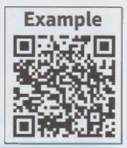
2.1 – Algebra – Algebraic Expressions
Page 8
Simplify
a 4 x n b g x 15
c 3m x 4 d e x f
e t ÷ 4 f d ÷ c
5 – Exam-Style Questions
Simplify
m + m + m -m + m (1 mark)
Simplify 3g x 5 (1 mark)
Simplify 5s + 4t + 2s + t
(2 marks)

Slide 66
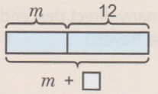
2.1 – Algebra – Algebraic Expressions
Page 8
Write an expression for these.
12 more than m
14 multiplied by n
p divided by 4
5 less than t
7 lots of x
y halved
Q6a hint

Slide 67
2.1 – Algebra – Algebraic Expressions
Page 8
R Leili is x years old.
Her sister is 3 years younger. Write an expression in x for Leili's sister's age.
Her uncle is 4 times as old as Leili. Write an expression in x for Leili's uncle's age.
Her brother is 2 years older than Leili.
Write an expression in x for Leili's brother's age.
Write and simplify an expression for the combined ages of all four.

Slide 68
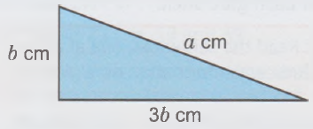
2.1 – Algebra – Algebraic Expressions
Page 8
Each pack of pens has x pens. Write an expression for the number of pens in
3 packs b 5 packs
c 16 packs d n packs
Write an expression for the perimeter P of the triangle.

Slide 69
2.2 – Algebra – Simplifying Expressions
Page 8
Copy and complete,
a 6 x 6 = 6□ b a x a = a□
c 7 x 7 x 7 x7=7□
d t x t x t x t=t□
Copy and complete.
a 32 x 33 = 3 □ b y² x y³ = y □
c n⁵ x n³ x n = n□
Write two terms that multiply together to give these answers.
a □ x □ = m³ b p⁵ c q¹⁰
Copy and complete,
a 6⁵ – 6³ = 6^{n} b X⁵ ÷ X³ = X□
c 7¹⁰ ÷ 7³ = 7□ d y¹⁰ + y³ = y □

Slide 70
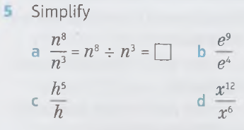
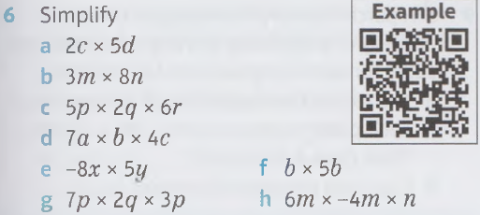
2.2 – Algebra – Simplifying Expressions
Page 8

Slide 71
2/2 – Algebra – Simplifying Expressions
Page 9
R Simon and Alexis work out the answer to: 4c x 5d x 3e
Simon's answer: 60cde
Alexis's answer: ecd60
Whose answer is correctly written?
Find the product of each pair of expressions connected by the six lines.

Slide 72
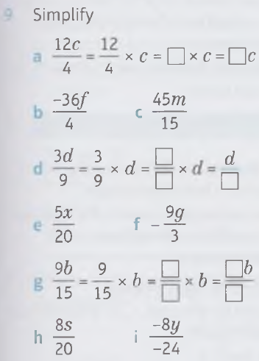
2.2 – Algebra – Simplifying Expressions
Page 9

Slide 73
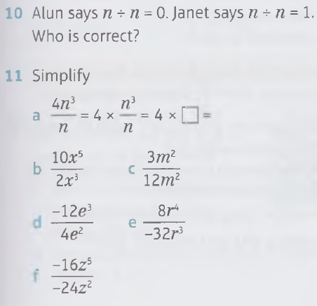
2.2 – Algebra – Simplifying Expressions
Page 9

Slide 74
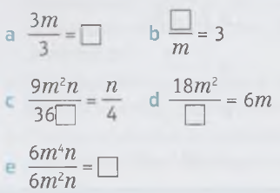
2.2 – Algebra – Simplifying Expressions
Page 9
R Insert the missing term in each equation. Choose from:
3m m² m

Slide 75
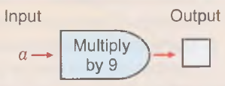
2.3 – Algebra – Substitution
Page 9
Write an expression for these statements. Use a to represent the starting number,
Elena thinks of a number and subtracts 21
Chris thinks of a number and multiplies it by 9
Afzal thinks of a number and divides it by 7
Q1b hint

Slide 76
2.3 – Algebra – Substitution
Page 9
Write an expression for these statements. Use n to represent the starting number.
Sonali thinks of a number, multiplies it by 3 then adds 7
Julia thinks of a number, multiplies it by 4 then subtracts 9
Louis thinks of a number, doubles it then divides by 5
Indira thinks of a number, divides it by 3 then adds 8
Michael thinks of a number, subtracts 5 then divides by 3

Slide 77
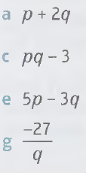
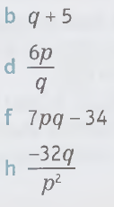

2.3 – Algebra – Substitution
Page 9
Work out the value of these expressions when p = 4 and q = 3

Slide 78


2.3 – Algebra – Substitution
Page 10
Find the value of each expression when x = 4, y = -3 and z = 5

Slide 79
2.3 – Algebra – Substitution
Page 10
5 – Exam-Style Questions
P = 9
Work out the value of 3p - 4 (2 marks) S = 4q + 9r
q = -3
r = 5
Work out the value of S. (2 marks)
A bag of sweets has c chocolate sweets and t toffee sweets.
Write an expression in c and t for the total number of sweets in the bag.
Use your expression to work out the total number of sweets in the bag when c = 8 and t = 11.

Slide 80
2.3 – Algebra – Substitution
Page 10
R Mira makes b biscuits.
She gives one to her mum. Write an expression in b for the number of biscuits Mira has left.
She gives one third of the remaining biscuits to her brother. Write an expression in b for the number of biscuits Mira gives to her brother.
Use your answer to part b to work out how many biscuits Mira gives to her brother when b = 10.

Slide 81
2.3 – Algebra – Substitution
Page 10
R a A bag of apple slices costs m pence.
Write an expression for the cost of 4 bags of apple slices.
A smoothie costs n pence. Write an expression for the cost of 3 smoothies.
Anya buys 4 bags of apple slices and 3 smoothies. Write an expression in m and n for the cost.
Use your answer to part c to work out how much Anya spends when m = 45 pence and n = 95 pence. Give your answer in pounds (£).

Slide 82
2.3 – Algebra – Substitution
Page 10
P A parcel delivery firm charges £15 for delivery of a parcel up to 10 kg in the UK, plus £2.50 for each kilogram over this amount,
The expression used to work out how much each parcel costs to send is £15 + £2.50k.
What does k represent?
Copy and complete the table.
Total mass of parcel | Amount over 10 kg | 15 + 2.50k
12 kg
15 kg
18 kg
25 kg

Slide 83
2.4 – Algebra – Formulae
Page 10
R A normal size packet of crisps costs p pence,
Write an expression in p for the cost of a bumper size packet of crisps that costs 25 pence more.
Write a formula for the cost, C, of the bumper size packet.
R There are 24 segments in a chocolate orange.
Write an expression for the number of segments in c chocolate oranges,
Using your expression, write a formula for the total number n of segments in c chocolate oranges.

Slide 84

2.4 – Algebra – Formulae
Page 10
R A hair scrunchie costs s pence.
Write formulae for the cost, C, of another hair scrunchie which costs
25 pence less
twice as much
one third as much.
The formula to work out the density of a substance is d = $\frac{M}{V}$ where d = density (in grams per cm³, g/cm³), m = mass (in grams, g) and V = volume (in cm³).
Use the formula to work out the density of these substances where
mass = 120g and volume = 40cm³
mass = 80g and volume = 16cm³

Slide 85
2.4 – Algebra – Formulae
Page 11
A formula to calculate the surface area of a cube is A = 6s², where s is the side length of the cube.
Calculate the surface area of a cube when
s = 4 cm
s = 6 cm
s = 20 cm
The formula for the distance travelled during a journey is d = st where d = distance, t = time and s = speed.
Work out the distance (d) in miles a car travels if it goes at:
60 miles per hour for 3 hours
50 miles per hour for 4 hours
70 miles per hour for 2½ hours

Slide 86

2.4 – Algebra – Formulae
Page 11
The formula for speed is s = $\frac{d}{t}$ where s = speed, d = distance and t = time. Work out the speed, s, in kilometres per hour, km/h, when
d = 80km and t = 2 hours
d = 240km and t = 8 hours
a cyclist travels a distance of 36 km in 3 hours
a helicopter travels a distance of 320 km in 2 hours.
8 – Exam-Style Questions
T - 6a - b
a - 4.5
b = 3.6
Work out the value of T. (2 marks)

Slide 87

2.4 – Algebra – Formulae
Page 11
Which of these are formulae and which are expressions?
3x - 4
d = st
v = u + at
$\frac{d}{t}$
V= lwh
v² + ma
Q9 hint - A formula always has an equals sign.

Slide 88

2.4 – Algebra – Formulae
Page 11
R Elaine is a waitress. She works h hours per day and is paid a rate of £p per hour.
Write a formula for Elaine's total pay per day, T, in terms of h and p.
Use your formula to work out T when h = T and p = 9.
At the end of each day Elaine and a colleague equally share the tips, t, they have earned together. Write a formula for R, the amount for tips that Elaine receives, in terms of t.
Use your formula for part c to work out Elaine's share of the
tips when t = £50.
Use your answers to parts
b and d to work out
Elaine's total earnings for
the day.

Slide 89
2.4 – Algebra – Formulae
Page 11
R A charm bracelet costs £20 for the bracelet and £12 for each charm,
Write a formula for the total cost, T, of a bracelet with c charms,
Use your formula to work out the cost of buying a bracelet with 8 charms.
In a right-angled triangle, b²= c² - a², where b is the length of the shortest side.
Find the length, b, of the shortest side, when
a a = 8, c = 10 b a = 12, c=13
c a = 4.7, c = 6.4 d a = 9.6, c=11.5
Round your answers to 1 d.p. where necessary.

Slide 90
2.5 – Algebra – Expanding Brackets
Page 11
Find the value of each expression when p = 3 and q = 4
a 3p(q-2) b 7(p + 3q)
c (2p + q)² d q(4p - 7)
e (3q)²
Workout
a 5(6 + 3)
b 5 x 6 + 5 x 3
c 4(7 + 2)
d 4 x 7 + 4 x 2

Slide 91
2.5 – Algebra – Expanding Brackets
Page 11
Expand the brackets.
a 4(x + 3) b 3(m + 5)
c 12(n - 3) d 7(4 - p)
e 5(3t + 4) f -3(b + 4)
g -6(4a + 1) h -5(x - 3)
i -(n + 7)
Q3i hint -(n + 7) is the same as
-1(n + 7)

Slide 92
2.5 – Algebra – Expanding Brackets
Page 12
R Luke and Aliya expand 5(3m – 2n).
Luke's answer is 15m + 10n.
Aliya's answer is 15m - 10m
Who is correct?
Expand
a x(x + 2) b m(m - 6)
c a(4a - 3)
Write an expression for each statement. Use a to represent the starting number.
I think of a number, add 5 and multiply by 3.
I think of a number, add 2 and multiply by 7.
I think of a number, subtract 3 and multiply by 4.

Slide 93
2.5 – Algebra – Expanding Brackets
Page 12
R A CD holds It + 3 tracks.
Write and simplify an expression for the number of tracks on 4 CDs.
When t = 15, how many tracks are there on 4 CDs?
Expand and collect like terms,
4(m + 3) + 5
6(x -4) + 12
n(n - 5) + 3n
-3 (a + 4) + 20
24 -3(4 -5f)
13x - (2x + 5y)

Slide 94

2.5 – Algebra – Expanding Brackets
Page 12
Expand and simplify
2 (a + 3) + 3 (a + 1)
5(2x + 5) - 4(x + 3)
3(4e - 3) + 2(e - 4)
Work out the value of these expressions:

Slide 95
2.5 – Algebra – Expanding Brackets
Page 12
R An electrician charges a £25 callout fee plus £30 per hour for each job she does,
A particular job takes j hours. Write an expression in j for the cost of the job.
Write a formula for the cost, C, in terms of j.
The electrician does four identical jobs, that each take j hours. Write a formula in j for her earnings, £7.
When j is 5, how much does the electrician earn for the four jobs?

Slide 96
2.5 – Algebra – Expanding Brackets
Page 12
R Gill is y years old and her brother is 4 years older. Her cousin is half the age of Gill's brother,
Write an expression for the age of Gill's brother.
Write an expression for the age of Gill's cousin.
Use your answer to part b to work out the age of Gill's cousin when Gill is 18.

Slide 97
2.5 – Algebra – Expanding Brackets
Page 12
R A joint of meat needs to be cooked for 60 minutes per kilogram plus 30 minutes extra. The oven needs to be warmed for 20 minutes before the meat can be cooked.
The expression 20 + 60(w + 0.5) represents the total amount of time the oven is on, in minutes.
Write what the terms in the expression represent.
w = 2. How long was the oven on for (in minutes)?

Slide 98


2.6 – Algebra – Factorising
Page 12
Q1a hint - Factors of -15 are:
-15, -5, -3, -1, 1,3, 5,15

Slide 99

2.6 – Algebra – Factorising
Page 12

Slide 100
2.6 – Algebra – Factorising
Page 13
Copy and complete. Check your answers by expanding the brackets,
7x + 28 = 7(x + □)
12p-18 = 6(□ - 3 )
15n + 9 = 3(□ + 3)
12s -27 = □(4s - □)
R Julia and Helen
factorise 12d + 18
Julia says the
answer is 6(2d + 3).
Helen says the answer is 3(4d + 6). Who is correct?

Slide 101
2.6 – Algebra – Factorising
Page 13
Factorise completely
a 8e + 24 b 4m – 20
c 18p + 9 d 25-15t
R Karl and Rashid factorise 18m – 6
Karl's answer is 6(3m - 0).
Rashid's answer is 6(3m - 1).
Who is correct? What mistake has the other student made?
Work out the HCFs of
a ab and a b m² and 2m
c pq and pr d 8ef and 24f
e 7d² and -21d f 8ab and 12b²

Slide 102

2.6 – Algebra – Factorising
Page 13

Slide 103
2.6 – Algebra – Factorising
Page 13
Factorise these completely. Expand your answers to check them,
a x² + 7x
b 6x² - 24x
c 8x + 12y
d 12y² - 3y
12 – Exam-Style Questions
Factorise 6a + 14b (1 mark)
Factorise a² + 9a (1 mark)

Slide 104

2.6 – Algebra – Factorising
Page 13
Which of these are true for all values of b rather than just some values of 6?
Rewrite any identities that you find, replacing
= with ≡
b + 4 = 6
3b + 9 = 3(b + 3)
b² = 9b
4b + 11 = 11 + 4b
Use = to write an identity for each of these expressions.
3x + 2x b $\frac{1}{3}$ x
2(x - 3) d x + 4

Slide 105

2.6 – Algebra – Factorising
Page 13

Slide 106

2.7 – Algebra – Using Expressions and Formulae
Page 13
Write a formula for P, the perimeter of each shape.

Slide 107
2.7 – Algebra – Using Expressions and Formulae
Page 14
Write an expression using u as the unknown starting number.
I think of a number, multiply it by 4 then add 3.
I think of a number, subtract 3 and then multiply by 5.
I think of a number, multiply it by 4 and divide by 3.
I think of a number, multiply it by itself then multiply by 2.
I think of a number, square it, then multiply by the original number again,
I think of a number, square root it and then add 2.
Q2 hint - Use a function machine.

Slide 108
2.7 – Algebra – Using Expressions and Formulae
Page 14
R Crisps are sold in multipacks or boxes. A multipack contains p packets of crisps and a box contains q packets of crisps,
Write an expression for the number of packets of crisps in 4 multipacks,
Write an expression for the number of packets of crisps in 5 boxes,
Grace buys 4 multipacks and 5 boxes for a tuck shop.
Write an expression in terms of p and q for the number of packets of crisps she buys,
Grace buys m multipacks and b boxes of crisps.
Write an expression in terms of p, q, m and b for the number of packets of crisps she buys,
When m = 5 and b = 3, use your answer to part d to work out how many packets of crisps Grace buys.

Slide 109
2.7 – Algebra – Using Expressions and Formulae
Page 14
R Darren scores m marks in his French listening exam.
Write an expression in terms of m for
his French speaking marks, 10 marks less than for his listening exam
his French reading marks, twice as much as the marks for his speaking exam
his French writing marks, twice as much as for his listening exam, plus another 6 marks.
Write and simplify an expression for Darren's total marks in his French exam,
Darren scored 30 marks in his French listening exam. Use your answer to part b to work out his total marks in his French exam.

Slide 110
2.7 – Algebra – Using Expressions and Formulae
Page 14
The formula to work out the voltage, V, of an electrical circuit is V=IR where I= current and R = resistance.
Work out V, in volts,
when I= 5 amps
and R = 12 ohms.
Use the formula
E= ½ mv² to work out E (in joules, J) when
m = 4 kg, v = 5 m/s
m = 6 kg, v = 10 m/s

Slide 111

2.7 – Algebra – Using Expressions and Formulae
Page 14
The formula a = $\frac{v −u}{t}$gives the acceleration of an object where a = acceleration (m/s²), u = initial velocity (m/s), v = final velocity (m/s) and t = time (s).
Work out the value of a when
u = 15 m/s, v = 60 m/s,
t = 5 s
u = 10 m/s, v = 46 m/s,
t = 6 s
Use the formula u² = v² - 2as to work out the value of u when
v = 0 m/s, a = -4m/s² and s = 8s

Slide 112

2.7 – Algebra – Using Expressions and Formulae
Page 14
9 – Exam-Style Questions
The selling price, S, of an item in a shop
can be worked out using the formula
S = $\frac{7C}{5}$ + 4 where C is the cost price,
Work out S when C = £15. (2 marks)
Which is cheaper to buy, an item with a selling price of £32 or an item with a cost price of £22?
Give reasons for your answer.
(2 marks)

Slide 113
2.7 – Algebra – Using Expressions and Formulae
Page 14
P To cook a joint of lamb takes 20 minutes per kg plus an extra 30 minutes.
a Flow long does it take to cook a 3.5 kg joint of lamb?
Write a formula for the number of minutes, M, it takes to cook a joint of lamb that weighs w kg.
Use your formula to find M when w = 5.
What time should you put a 2.5 kg joint of lamb in the oven to be ready for 6 pm?

Slide 114
2 – Algebra – Problem Solving
Page 14
Solve problems using these strategies where appropriate:
Use pictures
Use smaller numbers.
R a Using p = 5, show that 2p² is not the same as (2p)².
2p² can be the same as (2p)². What does p have to be for this to be true?
2 – Exam-Style Questions
Pat has x cards.
Jim has 4 more cards than Pat.
a Write down an expression, in terms of x, for the number of cards Jim has. (1 mark)
Lex has 2 times as many cards as Pat.
Write down an expression, in terms of x, for the number of cards Lex has. (1 mark)

Slide 115
2 – Algebra – Problem Solving
Page 15
P A factory makes nails. In one day, it makes 26,280 nails. Nine conveyors put the nails into boxes, each containing 40 nails,
How many boxes does each conveyor produce in one day?
Write an expression for the number of boxes produced by each conveyor when the factory makes n nails and puts them into boxes containing b nails using c conveyors.
Q3 hint - Read each sentence, one at a time. Replace each number with a smaller number and draw a picture to represent it.

Slide 116
2 – Algebra – Problem Solving
Page 15
R Andy and Liam are going out for the day. Their mum gave Andy y pence. She gave Liam 50p more. Their dad gave Andy 70p and Liam y pence.
Write an expression for the difference between their amounts of money,
Can you tell who has more from the information given? Explain your answer,
How much does y have to be for them to have the same amount of money?

Slide 117
2 – Algebra – Problem Solving
Page 15
A spring is s cm long. It stretches e cm for each 50g weight attached to it.
How long does the spring get when 200g is attached to it?
How long does it get when w g is attached to it?
To calculate the final velocity (v) of an object, you multiply the acceleration (a) by the time taken (£) and then add the initial velocity (u).
Write the formula for calculating final velocity (v) in terms of a, t and u.
Use your formula to work out v when u = 13 m/s, a = -2 m/s² and t = 5 s.

Slide 118
2 – Algebra – Problem Solving
Page 15
Henry has p friends. They each give him £b to buy a ball for the group. He gives them £k change each.
Write an expression in terms of b, k and p for the cost of the ball.
Use your expression to calculate the cost of the ball if there are 8 friends who each give him £5 and he gives them £2.24 change each.

Slide 119
2 – Algebra – Problem Solving
Page 15
A farmer is enclosing a square field with area 318,096 m². He wants to put the fence posts 2m apart.
How many fence posts will he need?
The fencing comes in rolls of 120 m. How many rolls does he need?
i Write an expression for the number of fence posts he needs for a field with Area A m².
ii How will your expression change if the farmer decides to put the fence posts 3m apart?
Write an expression for number of rolls of fencing he needs for a field with area A m², if the fencing comes in rolls of f m.

Slide 120
2 – Algebra – Problem Solving
Page 15
Seema is knitting a scarf. In each row, she knits 5 plain stitches then 3 purl stitches, 5 plain then 3 purl, and so on. Each row has this pattern 4 times,
She knits 17 rows. How many stitches is that?
How many stitches in a rows?
Different patterns can be made by varying the numbers of plain and purl stitches. Use d for the number of plain stitches, e for the number of purl and r for the number of times that the pattern is repeated in each row.
Write a formula for n, the number of stitches in a rows.
Put the values for Seema's scarf into your formula from part c. Do you get the same answer as in part a?

Slide 121
2 – Algebra – Problem Solving
Page 15
R Two expressions have a highest common factor of a and a lowest common multiple of a²b.
What could the expressions be?

Slide 122
3.1 – Graphs, Tables & Charts – Frequency Tables
Page 16
A primary school teacher records the number of pupils in each class. She records the data in a table.
Work out how many classes there are in the school.
Work out the total number of pupils in the school.
Number of pupils in a class | Number of classes
28 | 4
29 | 1
30 | 3
31 | 2

Slide 123
3.1 – Graphs, Tables & Charts – Frequency Tables
Page 16
A swimming pool records the ages of people at an 11—18s' evening.
12,15, 17, 13, 14, 16, 16, 11, 11, 13, 15, 16, 15, 16, 17
Copy and complete the grouped frequency table.
Age (years) | Tally | Frequency
11-12
13.14
Etc.

Slide 124
3.1 – Graphs, Tables & Charts – Frequency Tables
Page 16
For each inequality, list the numbers in the cloud that belong to it.
a 3 < x ≤ l 0 b 3 ≤ x < 9

Slide 125
3.1 – Graphs, Tables & Charts – Frequency Tables
Page 16
A Pilates instructor records the ages of people in the class:
27, 32, 34, 25, 37, 42, 49, 17, 19, 25, 52, 18, 22, 41, 54, 45, 44, 38, 19, 22
Copy and complete the grouped frequency table for this data.
What is the least common age group?
How many people are aged 25 or more?
Age a (years) | Tally | Frequency
15 ≤ a < 25
25 ≤ a < 35
35 ≤ a < 45
45 ≤ a < 55

Slide 126
3.1 – Graphs, Tables & Charts – Frequency Tables
Page 16
Alice measured the heights of 15 seedlings to the nearest mm:
15,17,19,13,14,16,17,21,
17, 18, 19, 18, 19, 12, 17
Is this data discrete
or continuous?
Design and complete a suitable grouped frequency table.

Slide 127
3.1 – Graphs, Tables & Charts – Frequency Tables
Page 16
Abene asked some students which was their favourite type of 'fast food' and recorded her results:
burger, pizza, burger, fish and chips, burger, fried chicken, fried chicken, pizza, burger, burger, pizza, fatafel, burger, fried chicken, fried chicken, burger, pizza, burger, fried chicken
Design and complete a data collection sheet for Abene's data.
Jacob records the number of cars passing his house each minute:
11, 14, 11, 9, 7,11, 10, 8,12, 15,18, 15, 14, 18,16
Design and complete a data collection sheet for Jacob's data.

Slide 128
3.1 – Graphs, Tables & Charts – Frequency Tables
Page 16
An athlete records the time it takes him to run the 100 m:
10.2, 10.1, 10.0, 10.9, 10.9,10.0, 10.1, 10.5, 10.2, 10.7,10.8, 10.0
Design and complete a data collection sheet for this data.
Q8 hint - Group the data.

Slide 129
3.2 – Graphs, Tables & Charts – Two-Way Tables
Page 16
Here is part of a train timetable.
How Long does the first train from Petersfield take to travel to London Waterloo?
Anika wants to arrive in London before 1245. What is the latest train she can catch from Petersfield?
Do all the trains take the same time from Petersfield to Guildford? Explain how you know.
Petersfield | 1031 | 1048 | 1117 | 1153
Haslemere | 1046 | 1103
Guildford | 1117 | 1134 | 1201
London Waterloo | 1149 | 1206 | 1233 | 1259

Slide 130
3.2 – Graphs, Tables & Charts – Two-Way Tables
Page 17
The distance chart shows distances in miles between four airports.
How far is it from
London Heathrow to Frankfurt
Charles de Gaulle, Paris, to Fiumicino, Rome
Frankfurt to Fiumicino, Rome?
London Heathrow
188 | Charles De Gaulle, Paris
397 | 297 | Frankfurt
891 | 685 | 601 | Fiumicino Rome

Slide 131
3.2 – Graphs, Tables & Charts – Two-Way Tables
Page 17
3 – Exam-Style Questions
Petersfield
17 | Stroud
15 | 15 | Steep
12 | 25 | 8 | Sheet
47 | 31 | 35 | 52 | East Meon
The chart shows the
time, in minutes, it takes
Mrs. Annery to walk
between villages around
Petersfield.
Write down the time it takes her to walk between Steep and East Meon. (1 mark)
Mrs. Annery walks from Stroud to East Meon. 17 minutes into the journey she stops for a rest.
Work out how much longer she must walk to reach East Meon.
(2 marks)
Write down the names of the two villages that Mrs. Annery can get between the most quickly. (1 mark)

Slide 132
3.2 – Graphs, Tables & Charts – Two-Way Tables
Page 17
The table shows the colour and size of hoodies that were ordered for students in Year 11.
How many more red hoodies, in total, were ordered than blue hoodies?
R Denis wants to know if James, Aran and India cycle, walk or drive to work. Design a form to collect the information.
 | Small | Medium | Large
Blue | 17 | 47 | 63
Red | 25 | 67 | 59

Slide 133
3.2 – Graphs, Tables & Charts – Two-Way Tables
Page 17
Use the two-way table to work out how many female students chose French.
R A commuter wants to know whether the trains are late, on time or early for each day of the week. Design a two-way table to record the data.
 | Male | Female | Total
French | 27 |  | 68
German | 32 | 45 | 77

Slide 134
3.2 – Graphs, Tables & Charts – Two-Way Tables
Page 17
A mattress comes in three levels of comfort - soft, medium and firm.
The mattress
can be covered
in one of three
fabrics –
patterned, plain
and textured.
The two-way table shows some information about the numbers of mattresses ordered in a shop one year.
How many soft patterned mattresses are ordered?
How many soft plain mattresses are ordered?
Copy and complete the two-way table.
 | Soft | Medium | Firm | Total
Patterned |  | 17 | 48 | 132
Plain |  | 26 | 24 | 65
Textured | 18 |  | 12 | 65
Total | 100 | 78 | 84

Slide 135

3.2 – Graphs, Tables & Charts – Two-Way Tables
Page 17
P There are 20 people in a coffee shop.
Each person has tea or coffee.
8 of the people are mate.
3 of the females had coffee.
A total of 12 people had tea.
Work out the number of males
who had tea.
P Anderley asked 40 people which TV channel they watched most the previous night - BBC, ITV or other.
Here is some information about her results.
12 of the 20 males watched BBC.
3 of the females watched ITV.
Of the 12 who said 'other', 5 were male.
Work out the number of women who watched BBC.
Q9 hint - Draw a two-way table.

Slide 136
3.3 – Graphs, Tables & Charts – Representing Data
Page 18
Amy and Max record the number of houses they each sell over 3 months.
Draw a comparative bar chart for the data,
In which month did they sell the most between them?
Compare the house sales in January and February.
 | January | February | March
Amy | 7 | 12 | 11
Max | 4 | 15 | 9

Slide 137
3.3 – Graphs, Tables & Charts – Representing Data
Page 18
2 – Exam-Style Questions
The table shows the numbers of cats, dogs and rabbits seen by a vet over 2 days.
Copy and complete the composite bar chart. (4 marks)
Compare the total number of appointments on Monday and Tuesday. (2 marks)
 | Monday | Tuesday
Cats | 5 | 2
Dogs | 12 | 3
Rabbits | 3 | 1

Slide 138
3.3 – Graphs, Tables & Charts – Representing Data
Page 18
Ellie asked a group of people how many minutes they spend exercising each week.
Her results are shown in the table.
Draw a histogram to display this data.
Age t (minutes) | Frequency
0 ≤ t < 30
30 ≤ t < 60
60 ≤ t < 90
90 ≤ t < 120

Slide 139
3.3 – Graphs, Tables & Charts – Representing Data
Page 18
R Here are a restaurant's takings over 3 days.
Draw a chart for this data.
Draw a line graph of the data in Q4.
 | Friday | Saturday | Sunday
Lunch | £350 | £300 | £450
Dinner | £400 | £550 | £150
Q6 hint - Draw two lines, one for lunch and one for dinner.

Slide 140
3.3 – Graphs, Tables & Charts – Representing Data
Page 18
An online music shop recorded the numbers of CDs and downloads it sold over 5 years.
Draw a set of axes. Put Year on the horizontal axis and Number sold on the vertical axis.
Draw a line graph for the number of CDs sold. Use a different colour to draw a line graph for the number of downloads sold,
Describe the trend in the number of CDs sold.
Describe the trend in the number of downloads sold.
Year | 1 | 2 | 3 | 4 | 5
CD’s (1000s) | 7 | 5.6 | 6.2 | 4.8 | 4.4
Downloads (1000s) | 2.8 | 3.4 | 3.6 | 4 | 4.6

Slide 141
3.4 – Graphs, Tables & Charts – Time Series
Page 18
The graph shows the share price of a company after it has been floated on the Stock Market.
What is the price of the shares after 4 days?
Estimate how long the shares were worth less than 350 pence.

Slide 142
3.4 – Graphs, Tables & Charts – Time Series
Page 19
A baby's weight for 4 weeks is shown in the table.
A nurse says, The baby's weight is increasing at a steady rate.‘
Is he correct? Explain how you know.
Week | 1 | 2 | 3 | 4
Weight (kg) | 4.5 | 4.7 | 5.1 | 5.2

Slide 143
3.4 – Graphs, Tables & Charts – Time Series
Page 19
A baby's weight for 4 weeks is shown in the table.
Draw a time series graph to represent the data.
Day | Mon | Tue | Wed | Thu | Fri | Sat | Sun
Temperature (⁰C) | 19 | 21 | 22 | 25 | 22 | 19 | 21
Q3 hint - Plot time along the horizontal axis and temperature on the vertical axis. The vertical axis needs to go up to 25. Join the points with straight lines.

Slide 144
3.4 – Graphs, Tables & Charts – Time Series
Page 19
A shop owner records the shop's monthly sales:
January: £3400
February: £2100
March: £2900
April: £2500
In May sales were twice those in January,
Construct a time series table for the shop,
Represent the data as a time series graph.

Slide 145
3.4 – Graphs, Tables & Charts – Time Series
Page 19
R A survey is carried out to find the numbers of people taking a holiday in the UK or abroad.
Represent the data as two time series on a single graph.
Describe the difference in the number of people taking holidays in the UK or abroad between 2010 and 2014.
Abel predicts the number of people taking a holiday in the UK could decrease in 2015.
Is he correct? Explain your answer,
What is likely to happen to the number of people taking holidays abroad in 2015 and 2016?
 | 2010 | 2011 | 2012 | 2013 | 2014
UK | 35 000 | 49 000 | 45 000 | 42 000 | 40 000
Abroad | 18 000 | 29 000 | 43 000 | 52 000 | 53 000

Slide 146
3.5 – Graphs, Tables & Charts – Stem & Leaf Diagrams
Page 19
The stem and leaf diagram shows the marks students scored in a test.
4 7 9 9
5 0 0 1 5 6 6
6 3 4 7 7
7 2
Key
4 7 represents 47%
How many students scored less than 60%?
What was the highest mark?

Slide 147
3.5 – Graphs, Tables & Charts – Stem & Leaf Diagrams
Page 19
A travel agent recorded the ages (in years) of people booking an adventure holiday in one week.
The information is shown in the stem and leaf diagram.
1 8 8 9
2 0 0 0 3 4 5 7
3 0 0 2 5 7 9 9 9
4 0 1 1 1 3
Key
4 8 represents 18
How many people booked the holiday?
How many were younger than 30?
What is the difference between the oldest and the youngest customers' ages?

Slide 148
3.5 – Graphs, Tables & Charts – Stem & Leaf Diagrams
Page 20
Here are the times (in minutes) 15 students spent on their homework.
18,19,25,33,18,19,32,39,
26, 27, 29, 30, 31, 34, 33
Construct a stem and leaf
diagram to show this
information.
4 – Exam-Style Questions
Here are the prices, in pounds (£), of 20 pairs of jeans:
35, 39, 41, 43, 44, 45, 22, 32, 29, 25, 46, 55, 59, 32, 22, 29, 28, 36, 25, 56
Show this information in an ordered stem and leaf diagram. (3 marks)

Slide 149
3.5 – Graphs, Tables & Charts – Stem & Leaf Diagrams
Page 20
Here are the distances (in metres) some athletes ran in 20 seconds.
190, 192, 195, 184, 176, 171, 189, 193, 199, 170
Draw a stem and leaf diagram to display the data.
Angel recorded the times (in seconds) it took some members of a running club to run 100 m.
11.2, 12.2, 12.5, 13.7, 13.2,12.9, 13.3, 14.4, 14.2, 12.9
Draw a stem and leaf diagram to display this data.
Q5 hint - Use the 'hundreds' and 'tens' digits as the stem.

Slide 150

3.5 – Graphs, Tables & Charts – Stem & Leaf Diagrams
Page 20
The weights of a group of patients at a hospital were recorded (in kg).
What is the lowest male weight?
What is the highest female weight?
What is the difference between the lowest female weight and the highest male weight?
Did more men than women weigh more than 80 kg? Explain your answer.

Slide 151
3.5 – Graphs, Tables & Charts – Stem & Leaf Diagrams
Page 20
The manager of a fitness suite records the ages (in years) of people using the gym and the swimming pool.
Gym: 19, 23, 27, 34, 26, 29, 33, 39, 45, 51, 35, 25, 29, 39, 38, 42
Swimming pool: 43, 29, 39, 38, 52, 43, 39, 28, 17, 39, 61, 43, 45, 34, 44, 19
Draw a back-to-back stem and leaf diagram to display the data,
The manager says, 'The swimming pool attracts more younger people than the gym.' Is she correct? Explain your answer.

Slide 152
3.5 – Graphs, Tables & Charts – Stem & Leaf Diagrams
Page 20
Charlie measures the heights of two sets of seedlings (in cm) kept in different parts of the greenhouse.
Draw a back-to-back stem and leaf diagram to display the data,
Did the seedlings grow better in Position A or Position B? Explain your answer.
Position A | 3.2 | 4.1 | 3.5 | 3.7 | 3.9 | 4.2 | 2.9 | 4.5 | 4.7
Position B | 4.2 | 5.1 | 4.9 | 3.5 | 3.7 | 2.9 | 3.9 | 5.3 | 5.2

Slide 153

3.6 – Graphs, Tables & Charts – Pie Charts
Page 20
A school surveyed its students for their opinion on how good their school lunches are. The pie charts show the results.
What fraction of students thought the food was good in 2014?
Compare the percentage of students who thought the food was OK in 2013 and 2014.
Do you think the food has improved?
Explain your answer.

Slide 154

3.6 – Graphs, Tables & Charts – Pie Charts
Page 21
A group of parents
were asked whether
they thought the
local park's
playground facilities
were good.
The results are
shown in the pie
chart.
What percentage of the parents said 'Don't know?
Measure the 'No' section with a protractor,
Mr Ethan says, 'More than three times as many people said 'Yes' as 'No'.‘
Explain why he is correct.

Slide 155

3.6 – Graphs, Tables & Charts – Pie Charts
Page 21
R The pie charts show a student's punctuality over two different terms.
There were 60 school days in the winter term and 52 in the spring term,
Calculate the number of days on which the student was late in the winter term,
The form teacher says, 'This student was late the same number of days in each term.' Is she correct? Explain your answer.

Slide 156
3.6 – Graphs, Tables & Charts – Pie Charts
Page 21
A librarian records the items borrowed from the library one day.
The information is shown in the table.
Work out the total frequency,
Work out the angle for
one item on a pie chart.
Work out the angle for each
type of item on a pie chart.
Draw a pie chart to
show the information.
Item | Frequency
Classic fiction book | 20
Contemporary fiction book | 30
Non-fiction book | 25
DVD | 10
CD | 5

Slide 157
3.6 – Graphs, Tables & Charts – Pie Charts
Page 21
5 – Exam-Style Questions
45 students choose to study a foreign language for GCSE.
The table shows the number of students who chose each language.
Draw an accurate pie chart to show the information shown in the table. (4 marks)
Language | Number of Students
French | 20
German | 15
Spanish | 9
Mandarin | 1

Slide 158
3.6 – Graphs, Tables & Charts – Pie Charts
Page 21
20 people purchased a hoodie in a shop one day. They each chose one of four colours:
green, yellow, green, blue, red, red, red, red, blue, yellow, blue, green, blue, red, red, red, blue, green, red, yellow
Draw a pie chart to show this information.

Slide 159
3.6 – Graphs, Tables & Charts – Pie Charts
Page 21
R The pie chart shows the percentage of visits to the vet clinic by different animals in one week.
20 dogs visited the vet clinic,
How many animals visited the vet clinic in total?
How many
i cats
ii rabbits
visited the
vet clinic?

Slide 160

3.6 – Graphs, Tables & Charts – Pie Charts
Page 21
A head teacher
asked some
students what
their favourite
weekday was.
She drew a pie
chart of her
results.
The head teacher knows that 20 students said 'Wednesday'. How many students were surveyed?
What is the modal favourite weekday?
Q8a hint - Measure the angle in the pie chart for Wednesday.

Slide 161
3.6 – Graphs, Tables & Charts – Pie Charts
Page 22
The owner of a car wash records the number of cars washed on three days.
Draw a bar chart for the data,
Now draw a pie chart.
Day | Monday | Tuesday | Wednesday
Number of Cars | 5 | 17 | 8

Slide 162
3.7 – Graphs, Tables & Charts – Scatter Graphs
Page 22
The age, in years, of some students and the time they took to run 100 m, in seconds, was recorded.
Draw a scatter graph to display the data,
Copy and complete the sentence.
As age increases, the time taken to run 100 m ..............................
Age (years) | 12 | 14 | 14 | 15 | 16 | 13
Time (s) | 20 | 16 | 15 | 15 | 13 | 17

Slide 163
3.7 – Graphs, Tables & Charts – Scatter Graphs
Page 22
Dr. Swan recorded the ages of nine patients and the number of times they had visited him in the last year.
Draw a scatter graph to display the data,
Copy and complete the sentence.
As a person's age increases, the number of visits to the doctor .......................
Age (years) | 25 | 39 | 49 | 62 | 74 | 18 | 35 | 82 | 93
Number of visits | 2 | 4 | 6 | 10 | 11 | 1 | 5 | 15 | 14

Slide 164
3.7 – Graphs, Tables & Charts – Scatter Graphs
Page 22
Look back at your graphs for Q1 and Q2. Describe the type of correlation in each one.
Match each real-life example to the correct type of correlation.
The relationship between height and weight
The relationship between eye colour and weight
The relationship between speed of train and time taken to travel 100 km
No correlation
Positive correlation
Negative correlation

Slide 165

3.7 – Graphs, Tables & Charts – Scatter Graphs
Page 22
5 – Exam-Style Questions
The lengths of time spent on a treadmill and the number of calories burned were recorded for 12 athletes. The data is shown in the scatter graph.
Describe the relationship between the length of time spent on the treadmill and the number of calories burned. (1 mark)
4 squares of chocolate contain 120 calories.
How many people did not burn off this number of calories?
(1 mark)
Q5a hint - This means write the type of correlation, so ____________ correlation.

Slide 166
3.7 – Graphs, Tables & Charts – Scatter Graphs
Page 22
An ice cream vendor records the maximum temperature and the number of ice creams sold each day for a week. The table shows the results.
Plot the information on a scatter graph.
One of the points is an outlier. Use your scatter graph to identify this outlier,
Describe the correlation between temperature and the number of ice creams sold.
Temp (⁰C) | 25 | 20 | 22 | 27 | 29 | 31 | 22
No. of Ice Creams sold | 100 | 73 | 90 | 140 | 152 | 170 | 149

Slide 167
3.7 – Graphs, Tables & Charts – Scatter Graphs
Page 22
The table shows the ages of some students and the distance they live from school.
Plot the information on a scatter graph.
Copy and complete the table.
Tick the correct type of correlation for each set of data and whether you think one causes the other.
Age (years) | 11 | 13 | 16 | 15 | 14 | 11 | 12 | 15 | 16
No. of Ice Creams sold | 3.2 | 1.8 | 4.5 | 13.6 | 2.3 | 4.5 | 8.6 | 1.0 | 9.5

Slide 168
3.7 – Graphs, Tables & Charts – Scatter Graphs
Page 23
 | Positive correlation | Negative correlation | No correlation | Possible causation
Age and number of hours spent watching TV
Income and weekly spend on food
Age of chicken and number of eggs laid
Speed of car and time to travel 10 miles

Slide 169
3.8 – Graphs, Tables & Charts – Line of Best Fit
Page 23
A fisherman recorded the mass and length of six trout. The table shows his results.
Draw a scatter graph for the data,
Draw a line of best fit on your graph.
Length (cm) | 35 | 37 | 38 | 37 | 41 | 43
Mass (g) | 600 | 755 | 810 | 720 | 870 | 930

Slide 170
3.8 – Graphs, Tables & Charts – Line of Best Fit
Page 23
A school records the number of days some students are absent and the distance they live from school.
Draw a scatter graph for the data,
Describe the correlation,
Can you draw a line of best fit?
Explain your answer.
Number of days absent | 3 | 8 | 1 | 4 | 7 | 3
Distance from school (miles) | 18 | 2 | 9 | 3 | 7 | 4

Slide 171
3.8 – Graphs, Tables & Charts – Line of Best Fit
Page 23
R Some students took two
maths papers, Calculator
and Non-calculator. The
table gives the percentage
marks for seven students.
Plot the points on a scatter graph.
Draw a line of best fit on the scatter graph.
Are there any outliers? Explain your answer.
Describe the relationship between the marks in the two papers.
Calculator (%) | 56 | 73 | 49 | 90 | 47 | 76 | 54
Non-Calculator (%) | 55 | 69 | 45 | 91 | 78 | 69 | 55

Slide 172
3.8 – Graphs, Tables & Charts – Line of Best Fit
Page 23
Eloise's mark in the Calculator paper is 65%. Estimate her mark in the Non-calculator paper.
Phil's mark in the Non-calculator paper is 97%. Use your line of best fit to estimate his mark on the Calculator paper.
Calculator (%) | 56 | 73 | 49 | 90 | 47 | 76 | 54
Non-Calculator (%) | 55 | 69 | 45 | 91 | 78 | 69 | 55

Slide 173

3.8 – Graphs, Tables & Charts – Line of Best Fit
Page 23
4 – Exam-Style Questions
The scatter graph shows information about 10 apartments in a city.
The graph shows the distance from the city centre and the monthly rent of each apartment.
Describe the relationship between the distance from the city centre and the monthly rent. (1 mark)
An apartment is 2.8km from the city centre,
Find an estimate for the monthly rent for this apartment. (2 marks)
March 2013, Q2,1MA0/1H

Slide 174
3 – Graphs, Tables & Charts – Problem Solving
Page 23
Solve problems using these strategies where appropriate:
Use pictures
• Use smaller numbers.
R The chart shows the number of animals seen by the local vet this month.
The total
number of
animals is 200.
Draw a bar
chart showing
the same
information.

Slide 175

3 – Graphs, Tables & Charts – Problem Solving
Page 24
This is part of a bus timetable.
You arrive at Honley Bridge New Mill Road at 11.30am.
What is the earliest time you could get to Holmfirth Bus Station?
How long will the bus ride take?
What is the earliest time you could get to Parkhead?
You can walk from Honley Bridge New Mill Road to Honley Bridge Woodhead Road in 10 minutes.
Could you get to either Holmfirth or Parkhead any earlier? Explain your answer.

Slide 176

3 – Graphs, Tables & Charts – Problem Solving
Page 24
A biscuit company is
looking at the production
of its three most popular
biscuits.
It records how many it
makes each three
months (rounded to the
nearest 100 000).
Draw a graph to help you answer these questions.
In which three months did the company make the most biscuits?
In which three months did the company make the fewest biscuits?
In which three-month period is the proportion of Plain Oaty Crunch the highest?
Comment on how the number of biscuits made varies through the year.
Q3 hint - How could you write these millions as smaller numbers on your graph? How will this make it easier for you to read values from your graph?

Slide 177
3 – Graphs, Tables & Charts – Problem Solving
Page 24
R Temi has chosen to study maths, economics and philosophy for A levels.
There are 120 students in Year 12. The Venn diagram shows the students that have chosen at least one subject in common with Temi.
How many students take exactly the same three subjects as Temi?
What fraction of Year 12 take maths?
How many students do not take any of the subjects that Temi takes?
What percentage have only one subject in common with Temi?
Why can you not represent this information in a two-way table?

Slide 178
3 – Graphs, Tables & Charts – Problem Solving
Page 24
5 – Exam-Style Questions
Felicity asked 100 students how they came to school one day.
Each student walked or came by bicycle or came by car.
49 of the 100 students are girls.
10 of the girls came by car.
16 boys walked.
21 of the 41 students who came by bicycle are boys.
Work out the total number of students who walked to school. (4 marks)
November 2012, Q21.1MA0I1F

Slide 179
3 – Graphs, Tables & Charts – Problem Solving
Page 25
P A vehicle hire company recorded the annual mileage of 25 vehicles.
21300 89614 21450 83199 30004 25600 94412 47708 67215 23118 48008 69401 13376 88583 93815 69030 96555 46917 40590 59780
72715 18168 42125 28288 42746
Choose a suitable way to group this data,
Represent your grouped data in a pie chart.

Slide 180
3 – Graphs, Tables & Charts – Problem Solving
Page 25
R a How does distance from school
relate to journey time? Write two sentences to explain.
Show your working.
The distances and journey times have been rounded. What have they each been rounded to?
Distance from school (km) | 12 | 5 | 40 | 2 | 3 | 10 | 5 | 17 | 6 | 9 | 12 | 4 | 3 | 2 | 8
Journey time (minutes) | 45 | 35 | 90 | 20 | 15 | 40 | 20 | 50 | 25 | 30 | 50 | 20 | 25 | 10 | 25

Slide 181

4.1 – Fractions & Percentages – Working with Fractions
Page 25
Write each pair of fractions with a common denominator.
a $\frac{1}{2}$ and $\frac{1}{3}$ b $\frac{7}{12}$ and $\frac{3}{4}$
P Millie has two bags of sweets, A and B.
For bag A, P(toffee) = $\frac{2}{3}$
For bag B, P(toffee) = $\frac{3}{5}$
From which bag is she more likely to choose a toffee sweet?
R Is $\frac{7}{12}$ > $\frac{2}{3}$ ?
Show your working to explain your answer.?

Slide 182


4.1 – Fractions & Percentages – Working with Fractions
Page 25
4 – Exam-Style Questions
Which of the two fractions $\frac{5}{6}$ and $\frac{3}{4}$ is the smaller?
Explain how you know. You may use the grids to help with your explanation. (3 marks)

Slide 183

4.1 – Fractions & Percentages – Working with Fractions
Page 25
a Write in order of size, starting with the smallest:
$\frac{5}{8}$, $\frac{2}{3}$, $\frac{7}{12}$
b Write in order of size, starting with the largest:
$\frac{3}{4}$, $\frac{7}{10}$, $\frac{4}{5}$
a R Predict which of
these fractions is largest:
$\frac{5}{12}$, $\frac{7}{8}$, $\frac{7}{9}$
b Work out which fraction is largest. Was your prediction correct?

Slide 184

4.1 – Fractions & Percentages – Working with Fractions
Page 25
a R Write two fractions
with the same numerator.
Explain how you can
tell which one is larger,
b Explain which is smaller, $\frac{6}{7}$ or $\frac{7}{8}$
Work out these calculations. Give each answer in its simplest form:
$\frac{1}{2}$ + $\frac{2}{5}$ b $\frac{2}{5}$ + $\frac{3}{10}$
$\frac{2}{3}$ - $\frac{1}{2}$ d $\frac{3}{4}$ - $\frac{1}{8}$
$\frac{7}{8}$ - $\frac{3}{16}$ f $\frac{1}{4}$ + $\frac{3}{8}$
$\frac{3}{5}$ - $\frac{2}{15}$ h $\frac{11}{16}$ - $\frac{1}{4}$
Q3 hint - Find the common denominator before adding or subtracting the fractions.

Slide 185

4.1 – Fractions & Percentages – Working with Fractions
Page 25
Work out:
$\frac{1}{2}$ + $\frac{2}{5}$ b $\frac{2}{5}$ + $\frac{3}{10} c \frac{2}{3}$ - $\frac{1}{2}$
R Rasheed is baking some cookies. It will take $\frac{1}{4}$ of an hour to make the mixture and $\frac{1}{3}$of an hour to bake the cookies.
What fraction of an hour will this take in total?
R A group of students went to an outdoor centre.
$\frac{1}{4}$ of them went canoeing and $\frac{2}{5}$ of them went sailing. The rest went mountain biking.
What fraction of the group took part in water-based activities?

Slide 186

4.1 – Fractions & Percentages – Working with Fractions
Page 26
P The ancient Egyptians only used unit fractions.
For $\frac{5}{8}$ they wrote $\frac{1}{2}$ + $\frac{1}{8}$
For which fraction did they write $\frac{1}{6}$ + $\frac{1}{4}$
How did they write $\frac{7}{10}$
Check your answer using a calculator.

Slide 187

4.1 – Fractions & Percentages – Working with Fractions
Page 26
Work out these. Give each answer in its simplest form.
a $\frac{1}{12}$ + $\frac{5}{8}$ b $\frac{1}{6}$ + $\frac{7}{10} c \frac{5}{6}$ - $\frac{3}{8}$
d $\frac{9}{10}$ - $\frac{5}{6}$ e $\frac{1}{6}$ + $\frac{3}{8} f \frac{3}{4}$ - $\frac{1}{6}$
Check your answers using a calculator.
Workout
a 1 - $\frac{1}{5}$ b 1 - $\frac{3}{8} c 2$ - $\frac{2}{3}$

Slide 188

4.2 – Fractions & Percentages – Operations with Fractions
Page 26
Workout
$\frac{3}{5}$ of 20
$\frac{5}{6}$ of 30
$\frac{4}{7}$ of 42
Find
a $\frac{2}{3}$ of 300 m b $\frac{5}{8}$ of 160 kg
A quiz has 60 questions. Marius gets $\frac{4}{5}$ of the questions What does he score?

Slide 189

4.2 – Fractions & Percentages – Operations with Fractions
Page 26
P Petra and Tom run a stall at a car boot sale. They split the money so that Petra gets $\frac{3}{5}$ and Tom gets the rest. They get £160 in total.
How much does Tom get?
Raj wants to put 6 filing cabinets along a wall in his office.
Each filing cabinet is 45cm wide.
The wall is 2.4 m long.
Show that Raj cannot fit 6 filing cabinets along the wall.

Slide 190

4.2 – Fractions & Percentages – Operations with Fractions
Page 26
6 – Exam-Style Questions
There are 12000 people at a rock festival on a particular day.
All of the people have a one-day pass, a two-day pass or are camping for all three days of the festival.
$\frac{1}{4}$ of the people have a one-day pass.
$\frac{3}{8}$ of the people have a two-day pass.
Work out how many people are camping at the festival. (4 marks)
Q6 hint - Check your answer gives a correct total number of people at the festival.

Slide 191

4.2 – Fractions & Percentages – Operations with Fractions
Page 26
R The frequency table shows the numbers of people skating on an ice rink at a particular time.
Lisa says, ‘In a pie chart, the women will be represented by $\frac{1}{6}$ of its area.’
Explain why Lisa is wrong.
People | Frequency
Men | 25
Women | 30
Boys | 25
Girls | 40

Slide 192

4.2 – Fractions & Percentages – Operations with Fractions
Page 26
P 120 children were asked their favourite flavour of crisps.
This pie chart shows the results.
How many
children chose cheese and onion?
Estimate the number of children who chose salt and vinegar.

Slide 193


4.2 – Fractions & Percentages – Operations with Fractions
Page 26
Work these out. Give your answers as mixed numbers.
Check your answers using a calculator.
Work out these calculations. Give each answer in its simplest form:
3$\frac{1}{3}$ + 2$\frac{1}{2}$ b 4$\frac{3}{4}$ + $3\frac{1}{2}$
7$\frac{1}{4}$ + $6\frac{1}{2}$ d 9$\frac{1}{2}$ + $4\frac{2}{3}$
2$\frac{1}{2}$ + $4\frac{1}{6}$ d 5$\frac{3}{5}$ + $4\frac{1}{2}$

Slide 194




4.2 – Fractions & Percentages – Operations with Fractions
Page 27
Work out
a 4$\frac{3}{4}$ - 3$\frac{1}{3}$ b 8$\frac{1}{2}$ - $4\frac{2}{3} c 12\frac{1}{3}$ - 9$\frac{3}{4}$
d 8- 2$\frac{1}{3}$ - 3$\frac{3}{5}$ e 7$\frac{1}{2}$ - 2$\frac{3}{4} f 9\frac{3}{5}$ - 6$\frac{1}{2}$
P In this diagram, the number in each box is the sum of the two numbers below it.
Find the missing numbers.
2$\frac{1}{4}$
1$\frac{1}{2}$
1$\frac{1}{4}$

Slide 195


4.3 – Fractions & Percentages – Multiplying Fractions
Page 27
Copy and complete.
Work these out. Write your answers as mixed numbers if necessary.
a 3 x $\frac{7}{3}$ b 4 x $\frac{5}{2} c 6 \text{x} \frac{7}{5}$
d $\frac{7}{4}$ x 7 e $\frac{12}{5}$ x 3

Slide 196

4.3 – Fractions & Percentages – Multiplying Fractions
Page 27
Sally has got 5 trifles to make. Each trifle will use $\frac{2}{3}$ pint of cream. Show that Sally will need 3$\frac{1}{3}$ pints of cream altogether.
R Yessim is selling his old laptop for £240.
He reduces the price by $\frac{1}{5}$
What is the new price?
Substitute x = 5 and y = 3 into:
$\frac{1}{2}$(x + 5) b $\frac{1}{3}(y$ + $6)$
$\frac{1}{4}\text{(}\text{x}\text{ + }\text{7}\text{)}$ d $\frac{1}{2}$ (x - y)

Slide 197

4.3 – Fractions & Percentages – Multiplying Fractions
Page 27
A mortar mix uses $\frac{3}{5}$ kg of sand for each kilogram of mortar.
How much sand is needed for 10 kg of mortar?
Work out:
$\frac{1}{3}$ x $\frac{1}{4}$ b $\frac{1}{2}$ x $\frac{1}{5}$
$\frac{2}{5}$ x $\frac{1}{4}$ d $\frac{1}{6}$ x $\frac{3}{5}$
$\frac{5}{6}$ x $\frac{2}{3}$ f $\frac{3}{7}$ x $\frac{4}{5}$
$\frac{4}{9}$ x $\frac{3}{8}$ h $\frac{3}{4}$ x $\frac{8}{9}$

Slide 198

4.3 – Fractions & Percentages – Multiplying Fractions
Page 27
P A footballer donates $\frac{1}{5}$ of his income to charity.
He makes £$\frac{3}{4}$ million in one particular season. How much money does he donate to charity that season?
Work out:
$\frac{3}{5}$ x $\frac{3}{4}$ b $\frac{7}{12}$ x $\frac{4}{5}$
$\frac{5}{7}$ x $\frac{8}{15}$ d $\frac{16}{21}$ x $\frac{7}{8}$
$\frac{11}{16}$ x $\frac{8}{15}$ f $\frac{7}{16}$ x $\frac{4}{21}$

Slide 199

4.3 – Fractions & Percentages – Multiplying Fractions
Page 27
In a running club, $\frac{2}{3}$ of the members are male. Of these, $\frac{1}{4}$ are under 16.
What fraction of the running club are male and under 16?
Dylan buys $\frac{5}{8}$ tonne of coal. He gives his mother $\frac{2}{5}$ of it.
Dylan needs 350 kg of coal to last for a month. Does he have enough?
Show how you worked it out.

Slide 200
4.3 – Fractions & Percentages – Multiplying Fractions
Page 27
12 – Exam-Style Questions
A concrete mixer can mix a maximum of 90 litres at a time.
If the mixer is two-thirds full, work out how much concrete (in litres) is being mixed. (2 marks)

Slide 201


4.3 – Fractions & Percentages – Multiplying Fractions
Page 27
Work out:
4 x 2$\frac{2}{3}$ b $5$ x 1$\frac{3}{7}$
3$\frac{3}{5}$ x $8$ d 4$\frac{2}{3}$ x 12
Jamie trains for 1$\frac{1}{4}$ hours every day for a marathon.
How long does he spend training each week (Monday to Friday)?
Q13a hint - Write 2$\frac{2}{3}$ as an improper fraction first, then multiply by 4

Slide 202

4.3 – Fractions & Percentages – Multiplying Fractions
Page 27
Briony needs 8 pieces of curtain material 2$\frac{1}{4}$ m in length. She has a 19 m length of material.
Does she have enough?
P Amy's parents need a mortgage to buy a house. They are offered two options.
Option 1: Two and a halftimes their joint salary
Option 2: Three and a half times the larger salary and two times the smaller salary.
Their salaries are £36000 and £43000.
Show which option would give them the larger mortgage.

Slide 203

4.4 – Fractions & Percentages – Dividing Fractions
Page 28
Write down the reciprocal of:
a $\frac{2}{3}$ b $\frac{1}{7} c 6$
Work out:
5 ÷ $\frac{1}{4}$ = 5 x □ = □
6 ÷ $\frac{1}{3}$ c. 8 ÷ $\frac{1}{6}$
5 ÷ $\frac{3}{5}$
How many $\frac{2}{3}$-litre soup bowls can you fill from a 3-litre saucepan of soup?
Work out these divisions. Write your answer as a mixed number if necessary.
7 ÷ $\frac{5}{2}$ b 10 ÷ $\frac{5}{4} c \text{6 ÷} \frac{15}{4}$

Slide 204

4.4 – Fractions & Percentages – Dividing Fractions
Page 28
Write down the reciprocal of:
$9÷2\frac{1}{3}$= 9 $÷$ $\frac{\text{□}}{3}=$
$12÷3\frac{1}{5}$ c. $8÷4\frac{2}{3}$
Work out:
$\frac{1}{4}÷3$ b. $\frac{3}{5}÷4$
$\frac{7}{4}÷8$ d. 2$\frac{4}{5}÷7$
Dave cycles 3$\frac{3}{4}$ km to work.
How far has he cycled when he is halfway?
Give your answer in metres.
Check your answer using an inverse operation.

Slide 205

4.4 – Fractions & Percentages – Dividing Fractions
Page 28
Leanne takes 3$\frac{3}{4}$ hours to do 5 tasks.
Each task takes the same time.
What fraction of an hour does 1 task take?
Work out these divisions. Write your answer as a mixed number if necessary.
$\frac{1}{4}÷\frac{1}{3}$= $\frac{1}{4}$ $x$ 3 = $\frac{\text{□}}{\text{□}}$
$\frac{5}{6}÷ \frac{1}{3}$ c. $\frac{7}{12} ÷ \frac{1}{4}$

Slide 206

4.4 – Fractions & Percentages – Dividing Fractions
Page 28
9 – Exam-Style Questions
Zara has 15m of ribbon. She needs $\frac{5}{6}$m of ribbon to make a wedding decoration.
How many wedding decorations can she make from this ribbon? (2 marks)
Q9 hint - Check your answer using the inverse operation.

Slide 207



4.5 – Fractions & Percentages – Fractions & Decimals
Page 28
1 – Exam-Style Questions
Write $\frac{9}{20}$ as a decimal
Copy and complete this table.
Decimal | 0.001 | 0.01 | 0.1 | 0.125 | 0.2 | 0.25 | 0.5
Fraction |  | $$\frac{1}{100}$$ |  |  |  |  | $$\frac{1}{2}$$

Slide 208

4.5 – Fractions & Percentages – Fractions & Decimals
Page 28
Write these fractions as decimals. Use your table from Q2 to help you:
$\frac{3}{5}$ = 3 x $\frac{1}{5}$ = 6 x □ =
$\frac{7}{8}$ c. $\frac{9}{2}$ d. $\frac{11}{4}$
Work out:
$\frac{1}{5}$ of 20 = 0.2 x 20 =
$\frac{3}{4}$of 20 c. $\frac{3}{2}$ of 12
$\frac{7}{10}$ of 400m
Q4 hint - Converting a fraction to a decimal can make a calculation easier.

Slide 209

4.5 – Fractions & Percentages – Fractions & Decimals
Page 28
Which of these fractions is closest to $\frac{1}{2}$ ?
$\frac{9}{20}$, $\frac{7}{12}$, $\frac{11}{15}$, $\frac{5}{8}$
Write these decimals as fractions in their simplest form.
0.77 b. 0.56 c. 0.433
0.650 e. 0.072
Write these in order of size, starting with the smallest.
$\frac{7}{9}$, 0.72, $\frac{3}{4}$, 0.7
$\frac{1}{3}$, 0.3, $−\frac{15}{4}$, 0.34
$\frac{7}{2}$, -3.6, -$\frac{15}{4}$, 2.9

Slide 210

4.5 – Fractions & Percentages – Fractions & Decimals
Page 28
R Jamilla says that $\frac{1}{9}$ of 350m is 38.89m rounded to the nearest centimetre.
Show that Jamilla is correct.
R Jill and Claire share an £80 restaurant bill. Jill pays $\frac{5}{6}$ and Claire pays $\frac{1}{6}$.
How much does each pay?
Will the amounts in your answers to part a pay the whole bill?
Should you round up or down when sharing a bill?

Slide 211


4.5 – Fractions & Percentages – Fractions & Decimals
Page 29
R Ruby uses this formula to work out the time needed to cook a joint of meat.
Time (hours) = $\frac{10 x mass (kg)}{9}$.
A joint of meat weighs 6 kg.
Work out the cooking time. Give your answer in hours and minutes.
Alex draws a
pie chart to
show the ways
students travel
to school.
Show that the
fraction of
students who
come by bus
is$\frac{12}{36}$.

Slide 212
4.5 – Fractions & Percentages – Fractions & Decimals
Page 29
Fiona's bus fare to work was £1.50. It goes up to £1.80.
Write the new bus fare as a fraction of the old bus fare.
Give your answer in its simplest form.
Luke buys a house for £150000. He sells it several years later for £200000.
Write the selling price as a fraction of the original price in its simplest form.
Write 24 minutes as a fraction of an hour in its simplest form.

Slide 213

4.6 – Fractions & Percentages
Page 29
Write as a fraction in its simplest form
a 12% b 35% c 55%
d 84% e 4%
95% of students have a mobile phone.
Write this percentage as a fraction in its simplest form.
Show that 18% is smaller than $\frac{1}{5}$.

Slide 214
4.6 – Fractions & Percentages
Page 29
A group of 20 students chose a sporting activity.
8 chose tennis. The rest chose volleyball.
What percentage chose
tennis
volleyball?
Add together your answers to parts a and b. Write a calculation to work out the percentage who chose volleyball, using the percentage that chose tennis.

Slide 215

4.6 – Fractions & Percentages
Page 29
R A company wants to give a reduction of between 30% and 40% on its bicycles.
Which of these fractions could they use?
$\frac{9}{20}, \frac{1}{4}$, $\frac{3}{8}$
Show your working to explain your answer.
R Danny says that $\frac{1}{6}$ is 15%.
Show that Danny is wrong.

Slide 216

4.6 – Fractions & Percentages
Page 29
Hasan does a survey on people's favourite type of music. He draws a bar chart to show his results.
What percentage of people chose rock music?
Hasan says that half as many people like folk and classical music as like pop.
Show that Hasan is incorrect.

Slide 217
4.6 – Fractions & Percentages
Page 30
Write
35 as a percentage of 50
520 as a percentage of 800
75p as a percentage of £2.50
900 m as a percentage of 3.6 km
R Elsa got 34 out of 40 in a quiz. Marcus scored 80% in the same quiz. Who achieved the higher score? Explain your answer.
Q8c,d hint - Write both amounts in the same units.

Slide 218
4.6 – Fractions & Percentages
Page 30
R Harvey took a chemistry test and a biology test.
He scored 56 out of 70 for chemistry and 65 out of 80 for biology.
In which test did Harvey score the lower percentage?
There are 270 students in Year 11 at a school.
175 of them want to study A levels.
What percentage of the students want to study A levels?
Round your answer to the nearest whole number.

Slide 219
4.6 – Fractions & Percentages
Page 30
12 – Exam-Style Questions
A TV channel shows 225 programs in the course of a week. 21 of these are news programs.
What percentage of the programs are news programs?
Give your answer to 1 decimal place. (3 marks)

Slide 220


4.7 – Calculating Percentages 1
Page 30
Write these percentages as decimals:
a 35% b 28%
The diagram shows a fraction-decimal-percentage triangle.
Draw fraction-decimal-percentage triangles for
$\frac{3}{4}$ b 40% c 0.7 d $\frac{3}{8}$

Slide 221

4.7 – Calculating Percentages 1
Page 30
Write in order of size, starting with the largest:
$\frac{3}{4}$ 0.7, $\frac{13}{20}$, 78%
$\frac{1}{3}$ 3.5%, 0.3, $\frac{2}{5}$
A credit card has an interest rate of 14.9%. Write this percentage as a decimal.
a Write 25% as a fraction,
b Work out 25% of 2500.
Q3 hint - Convert to decimals.

Slide 222
4.7 – Calculating Percentages 1
Page 30
Workout
80% of 600
30% of 700
40%of 800
a Write 40% as a decimal,
b Work out 40% of 500.
Work out these percentages by converting to a decimal first.
70%of 350
65%of 400
15%of 260

Slide 223

4.7 – Calculating Percentages 1
Page 30
Judith buys a dress originally costing £80 reduced by 45% in a sale.
How much money does Judith save?
James wants to buy some new trainers costing £65.99.
He has two vouchers. Which voucher should James use? Explain your answer.

Slide 224
4.7 – Calculating Percentages 1
Page 31
On Saturday a shoe shop sells 90 pairs of children's shoes.
30% of the children's shoes sold are boys' shoes. How many pairs of children's shoes are not boys' shoes?
P Alima's family own a shop. They have to pay an annual business council tax of £1265.60
A 10% discount is applied as they are a new business.
The council says they should pay £94.92 each month for the year.
Check that the council are charging correctly. Show your working.

Slide 225
4.7 – Calculating Percentages 1
Page 31
P Leanne sells a dining table at an auction. She pays £7.50 to put the table in the auction and 8% of the selling price as a fee.
The table sells for £175.
How much does Leanne have to pay?
Write as a decimal
a 160% b 115% c 430%
Petrol costs 2½ times as much today as it did 20 years ago.
What percentage has it increased by?

Slide 226
4.7 – Calculating Percentages 1
Page 31
Work out
a 120% of £60
b 175% of 300 m
c 350% of 400 kg
An antiques dealer buys a grandfather clock for £6000. He sells it at 140% of this cost.
How much did the antiques dealer sell the clock for?
A greengrocer buys onions for 36p per kg and sells them at 275% of the cost price.
How much does the greengrocer sell 1200g of onions for? Write your answer to the nearest penny.

Slide 227
4.7 – Calculating Percentages 1
Page 31
Find the simple interest when:
£4000 is invested at
3.75% per annum
(p.a.) for one year
£750 is invested at
2.25% p.a. for 4 years
£6000 is invested at
3.2% p.a. for 30 months.
Ella's grandfather gives her £2500. She saves the money in a bank account with a simple interest rate of 3.4% per annum.
How much money will Ella have in the bank account after 3½ years?.

Slide 228
4.7 – Calculating Percentages 1
Page 31
P The cost of living increased by 30% from 2004 to 2014.
In 2004, the Smith family's weekly income was £420.
What would you expect their weekly income to be in 2014 if it increased at the same rate as the cost of living?
Rashid buys a car for £15900.
The value of the car depreciates by 14% each year.
Work outa the value of the car at the end of the first year he has owned it.
Q22 hint - 'Depreciates' means that the value of the car decreases.

Slide 229

4.7 – Calculating Percentages 1
Page 31
23 – Exam-Style Questions
Alice earns an income of £1340 each month. She spends 45% of her income on rent.
She spends $\frac{1}{3}$ of her income on food and bills.
Work out how much she has left each month. (2 marks)

Slide 230
4.8 – Calculating Percentages 2
Page 31
Increase:
45 by 40%
300 by 67%
4000 by 0.3%
Danny works part
time for £54 per week. His employer agrees to raise his weekly wage by 4%. What is Danny's new weekly wage?
Decrease:
65 by 20%
800 by 35%
3000 by 0.7%

Slide 231
4.8 – Calculating Percentages 2
Page 31
P A sofa company reduces its prices by 35%. A sofa was £600.
What is the new price of the sofa?
P Mia wants to improve her 1500 m running time by 5%.
Her current time is 6 minutes.
What is her new target time?
The cost of sending a parcel is increasing by 20%. A 2 kg parcel costs £12 to send,
Work out 20% of £12.
Work out the new price to send the parcel,
Work out 120% of £12.
What do you notice about your answers to parts b and c? Explain.

Slide 232
4.8 – Calculating Percentages 2
Page 32
Write the decimal multiplier you can use to work out an increase of
a 30% b 64% c 2.5%
Increase:
160 by 150%
600 by 300%
4000 by 7.5%
Write the decimal multiplier you can use to work out a decrease of:
30% b 45%
4% d 7.5%

Slide 233
4.8 – Calculating Percentages 2
Page 32
Decrease
400 by 30%
700 by 65%
160 by 15%
4000 by 7.5%
P A 5% discount is deducted from the cost of a meal as a special offer.
A meal cost £65. What is the total charge?

Slide 234


4.8 – Calculating Percentages 2
Page 32
12 – Exam-Style Questions
Gemma is buying shampoo for her hair salon. She finds out the cost at two suppliers.
Gemma needs 60 bottles of shampoo.
She wants to buy it all from the same supplier, at the cheapest possible total price. Which of the two suppliers should Gemma buy the shampoo from?
(6 marks)
Exam hint
Make sure you make a statement at the end that includes the cost of the shampoo and which shop Gemma should buy it from.

Slide 235
4.8 – Calculating Percentages 2
Page 32
R Amit is self-employed. Last year, he earned £28640.
He does not pay income tax on the first £10000 he earned.
He pays tax of 20% for each pound he earned above £10000.
How much tax must he pay?
P Sergei gets two quotes for roof repairs.
Quote 1: £780 including VAT Quote 2: £675 excluding VAT
Which is the more expensive quote? Show your working.
Q14 hint - VAT is charged at a rate of 20%. It is added to the bill in addition to the cost of the work.

Slide 236
4.8 – Calculating Percentages 2
Page 32
P Aisha buys 3 tickets for a concert.
The cost of one ticket is £68 plus VAT.
VAT is 20%. Work out the total cost of the tickets.
P Alex is planning a raffle.
Each winner will get a gift voucher costing £30 plus VAT at 20%.
Alex has up to £200 to spend on prizes.
How many gift voucher prizes will there be?

Slide 237

4.8 – Calculating Percentages 2
Page 32
P A family of 2 adults and 3 children are going on holiday.
The adult price for the holiday is £480.
The company is offering a discount of $\frac{1}{4}$ off adult prices, and a child costs 35% of the original adult price.
Work out the total cost of the holiday.
R A sports centre manager predicts that there will be a 30% increase in membership during January.
There are currently 650 members of the leisure centre.
How many members does the manager predict there will be by the end of January?

Slide 238

4 – Problem Solving
Page 32
Solve problems using these
strategies where appropriate:
Use pictures
Use smaller numbers
Use bar models.
R Show that $\frac{3}{5}$ < 70%.
Sarah, Abz and Nadine share a flat. The rent is £720 a month. Sarah gets the largest room.
She pays $\frac{3}{8}$ of the rent. Abz pays 60% of the rest of the rent and Nadine 40%.
Work out how much Abz and Nadine each pay.
Q1 hint - Use a bar model. Divide the bar into 10% sections.

Slide 239
4 – Problem Solving
Page 33
R Michael scores 19 out of 25 in a science test, 78% in a history test and only gets 4 wrong in a maths test out of 20.
Which subject is he performing best in?
Explain your answer.
R Adam is 4 years older than Sam. Charles is twice as old as Sam.
Use s to represent Sam's age.
Write an expression for the sum of their ages. The sum of their ages is 36 years,
Write an equation for the sum of their ages.
How old are Sam, Adam and Charles?

Slide 240
4 – Problem Solving
Page 33
R Marta earns £28225 a year. She is offered four choices for a pay rise.
No increase in year 1, then 15% in year 2
8% in year 1 with no increase in year 2
5% in year 1, then another 5% in year 2
6% in year 1, then 4% in year 2
Which should she choose? Explain your answer.
Q5 hint - How can you use simple numbers to help you?

Slide 241
4 – Problem Solving
Page 33
R Henry says, 'I have 25 g of salt in 2000 g of this salt solution.'
What is the percentage of salt in his salt solution?
He wanted the solution to have a 0.5% concentration.
Does he have too much or too little salt in the solution? Explain.
How much salt should have been in the solution?

Slide 242
4 – Problem Solving
Page 33
7 – Exam-Style Questions
Liam borrows £12350 to buy a car. He pays the money back with simple interest at a rate of 14% over the next 5 years,
How much interest will he pay on the loan? (3 marks)
How much would he save if he paid off the loan in 3 years instead of 5?
(2 marks)

Slide 243

4 – Problem Solving
Page 33
In a class of 25 students, 5 students don't have a dog or a cat.
Of the rest, 13 have a dog and 11 have a cat.
How many have only a cat?
R Paul and Avish are mixing drinks for their friends. They pour 1½ cups of orange squash and $\frac{3}{5}$ of a cup of pineapple squash into a 6-cup jug. They then fill the jug up with water,
How much water is in the jug?
Avish says the amount of water is nearly double the amount of squash. Is he right?
Explain your answer.

Slide 244

4 – Problem Solving
Page 33
Lore gives Rose and Margaret all her bottles of nail varnish.
Rose gets $\frac{7}{20}$ of them. This is 24 fewer than Margaret gets.
How many bottles of nail varnish were there to begin with?
Margaret sells $\frac{4}{13}$ of hers for £2.50 a bottle.
What percentage of Lore's set did Margaret sell?
How much did she make?

Slide 245

4 – Problem Solving
Page 33
This is a plan of Katie's bedroom.
She wants to buy coving to line all around the edges of the ceiling.
What length of coving does she need?
She also wants to tile the floor. The tiles are 50 cm by 50 cm.
How many tiles will she need to cover her floor?

